Slide 1
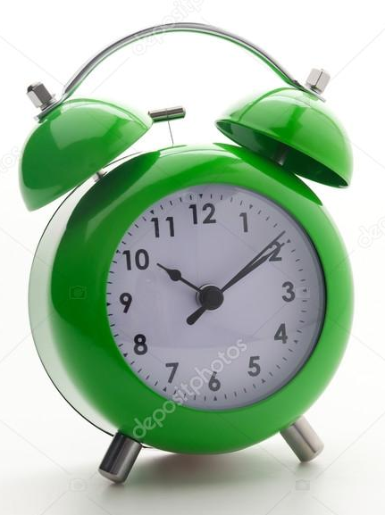
Розпорядок дня. Годинник
Підготувала
Вчитель англійської мови
Наталія Гомечко

Slide 2

Rain, rain go away,
Come again another day.
Little Johnny wants to play,
Rain, rain go away.

Slide 3

Yes
No
My favourite is…

Slide 4
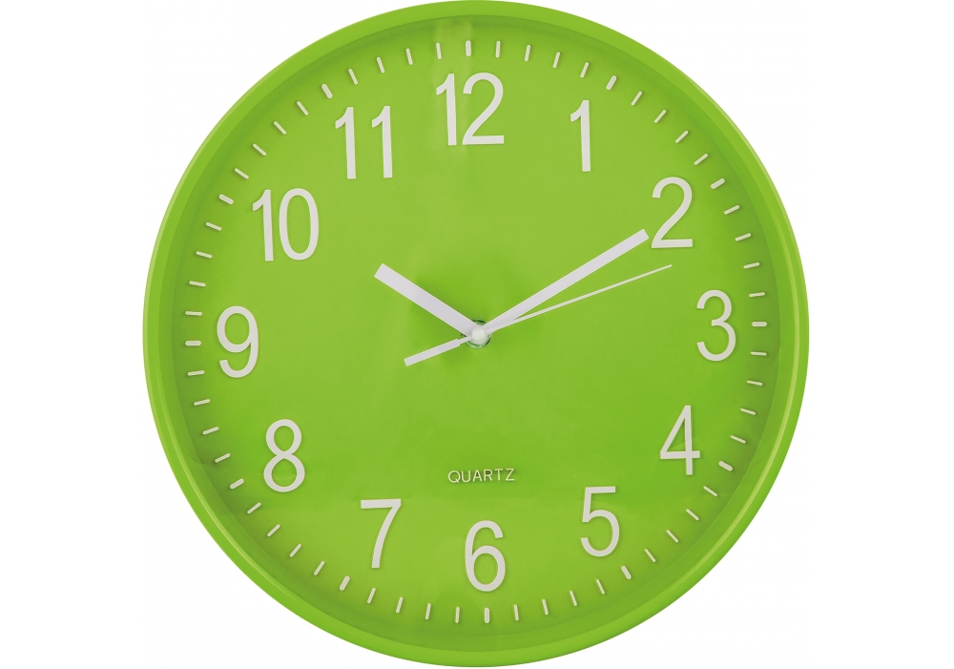
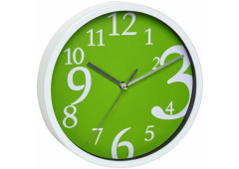

WHAT TIME IS IT?

Slide 5
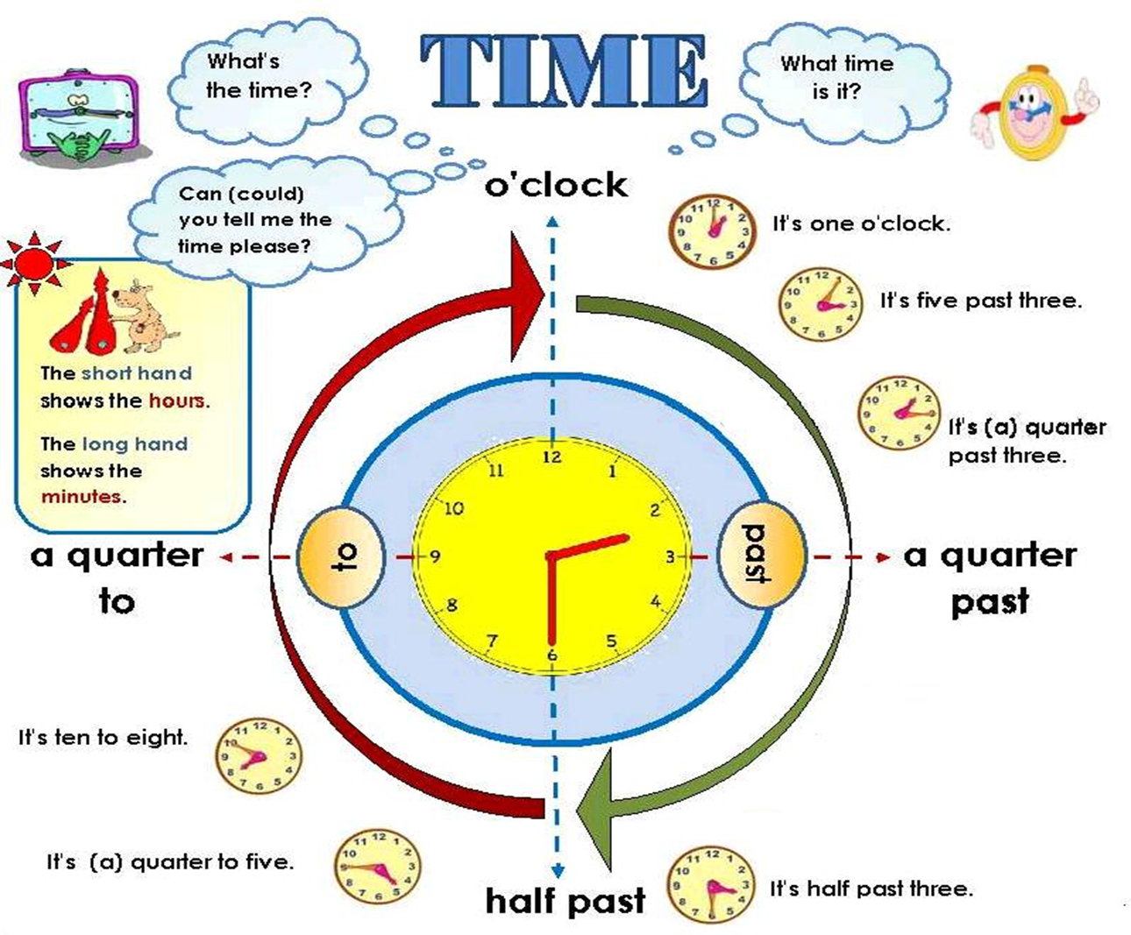

Slide 6
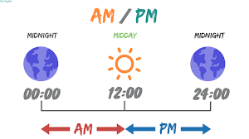
Remember!
До полудня (00:00-12:00): АМ
Після полудня ( 12:00-24:00): РМ
a.m. – in the morning
p.m. – in the evening

Slide 7
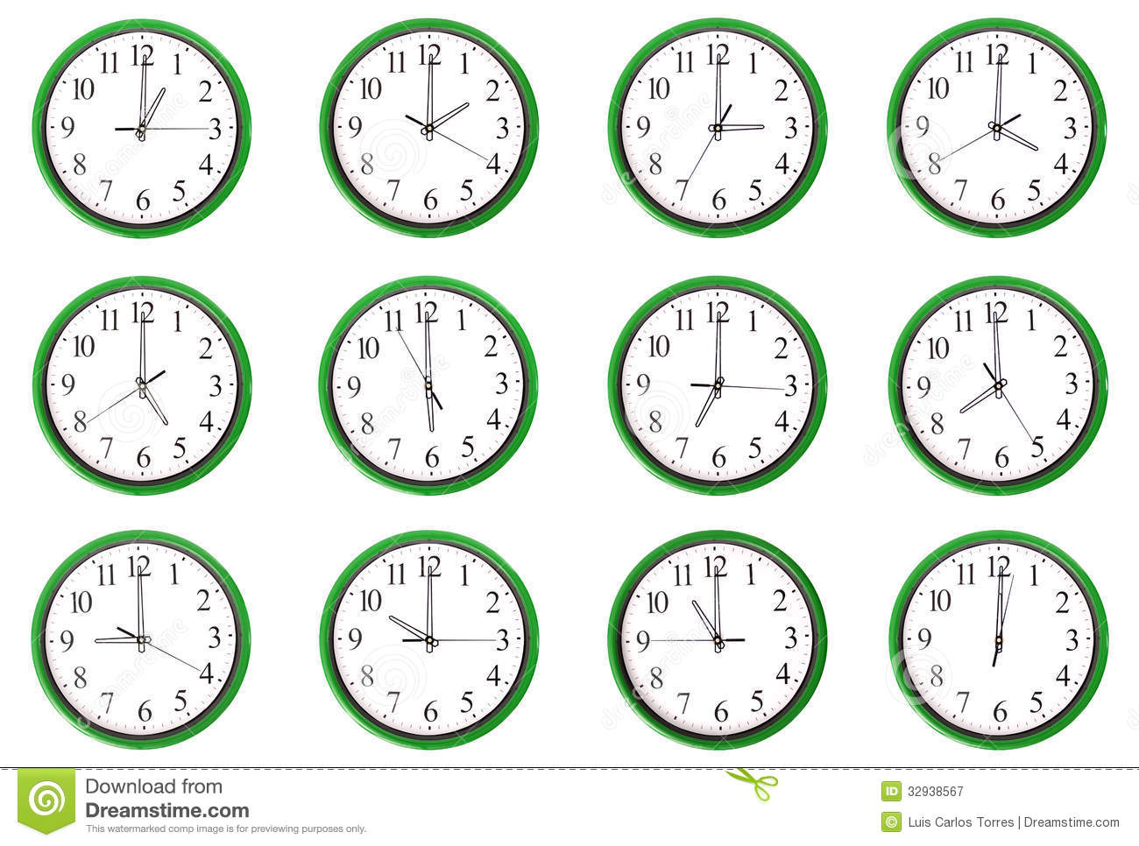

Slide 13





Slide 14





Slide 15
I usually get up at…
I usually have my breakfast at…
My school starts at…
I usually go to bed at…

Slide 16
Thank you for the lesson.
Goodbye =)

