Slide 1
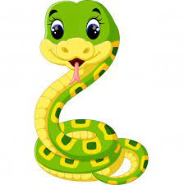
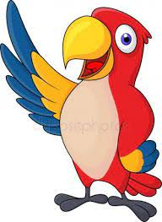
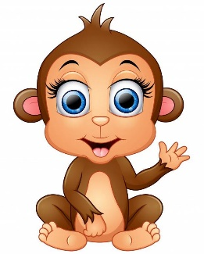
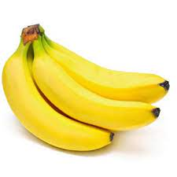
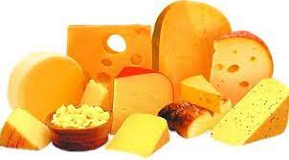
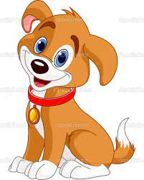
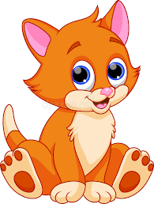
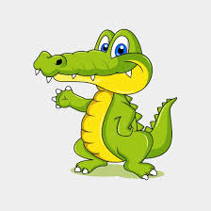
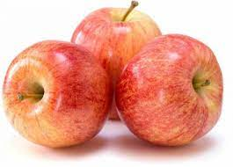
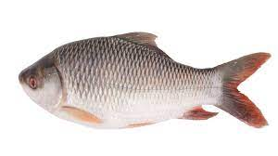
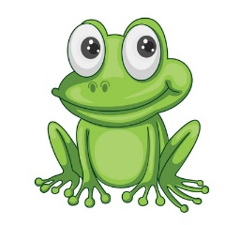
Does he/she like … ?

Slide 2
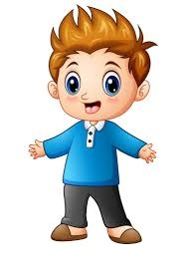
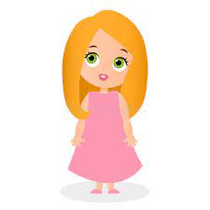
Hello! I’m Mark
Hello! I’m Emma

Slide 3

Does Mark like bananas? –
Yes, he does.

Slide 4

Does Emma like crocodiles? –
No, she doesn’t.

Slide 5
Yes, he does.
Does Mark like dogs? –

Slide 6
No, she doesn’t.
Does Emma like parrots? –

Slide 7
No, he doesn’t.
Does Mark like snakes? –

Slide 8
Yes, she does.
Does Emma like cats? –

Slide 9


Does Mark like monkeys? –
Yes, he does.

Slide 10
Does Emma like bananas? –
No, she doesn’t.

Slide 11
Does Mark like apples? –
No, he doesn’t.

Slide 12
Does Emma like apples? –
Yes, she does.

Slide 13
Does Mark like cheese? –
No, he doesn’t.

Slide 14
Does Emma like cheese? –
Yes, she does.

Slide 15
Does Mark like fish? –
Yes, he does.

Slide 16
Does Emma like fish? –
Yes, she does.

Slide 17

Well done!

