Slide 1
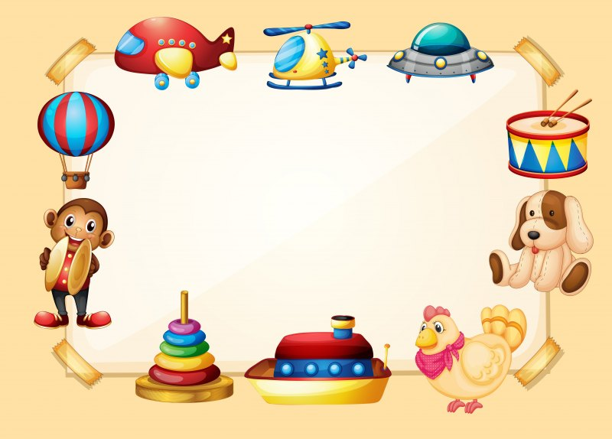
MY TOYS
Підготувала :Руденко Л.В

Slide 2
Hello!
How are you?

Slide 3
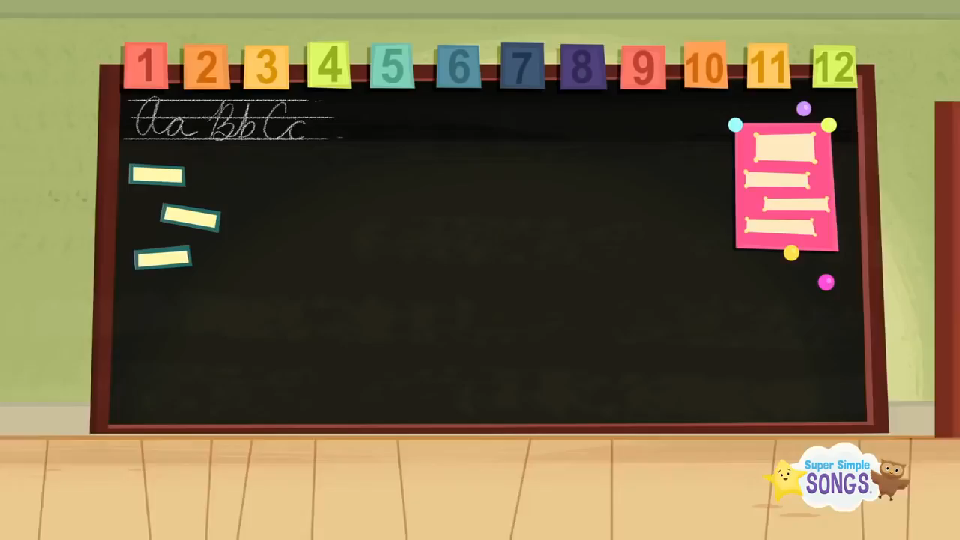

Slide 4
What is it?
It is…

Slide 5
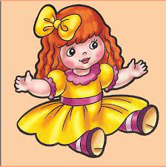
a doll

Slide 6

a ball

Slide 7

a bell

Slide 8
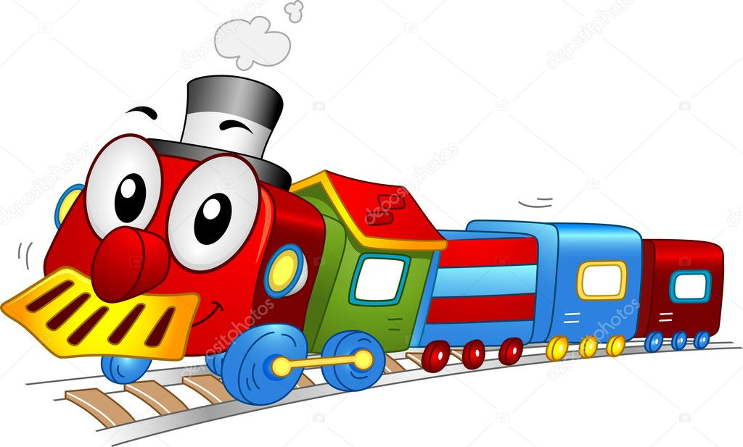
a train

Slide 9

a plane

Slide 10

Christmas Tree

Slide 11
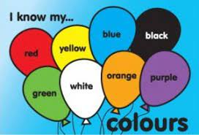
Colours

Slide 12
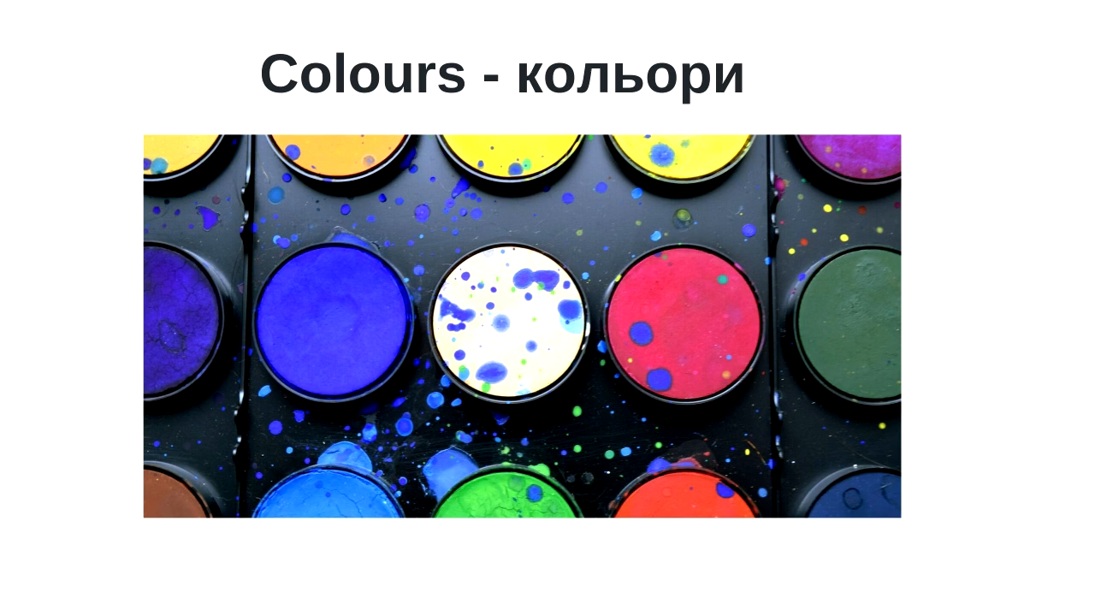

Slide 13
I like…

Slide 14

Bye!

