Slide 1


Slide 2
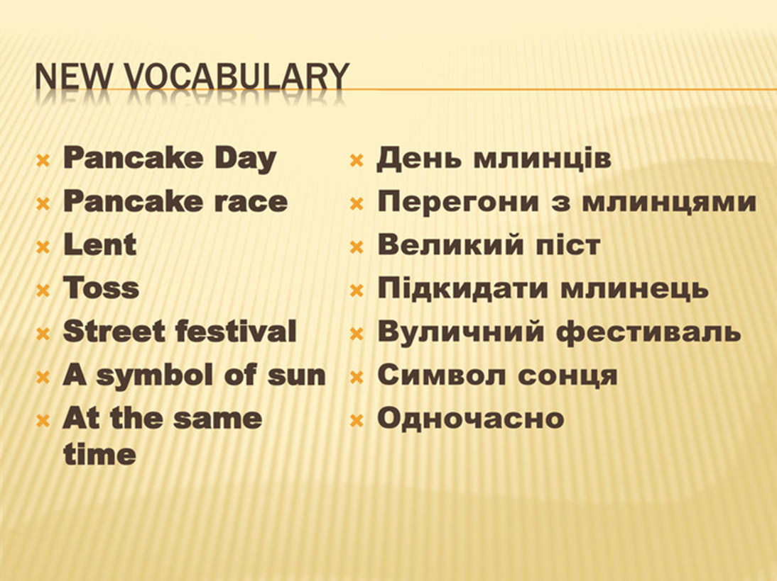

Slide 3


Slide 4
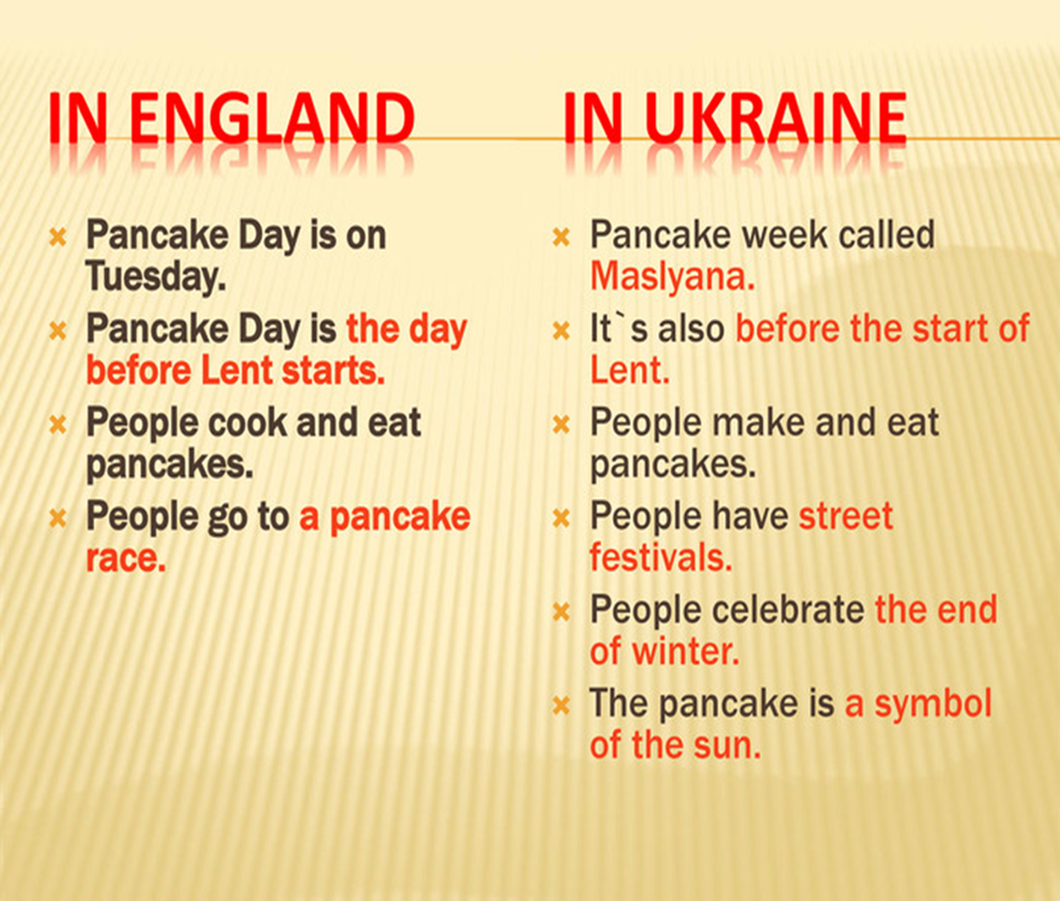

Slide 5
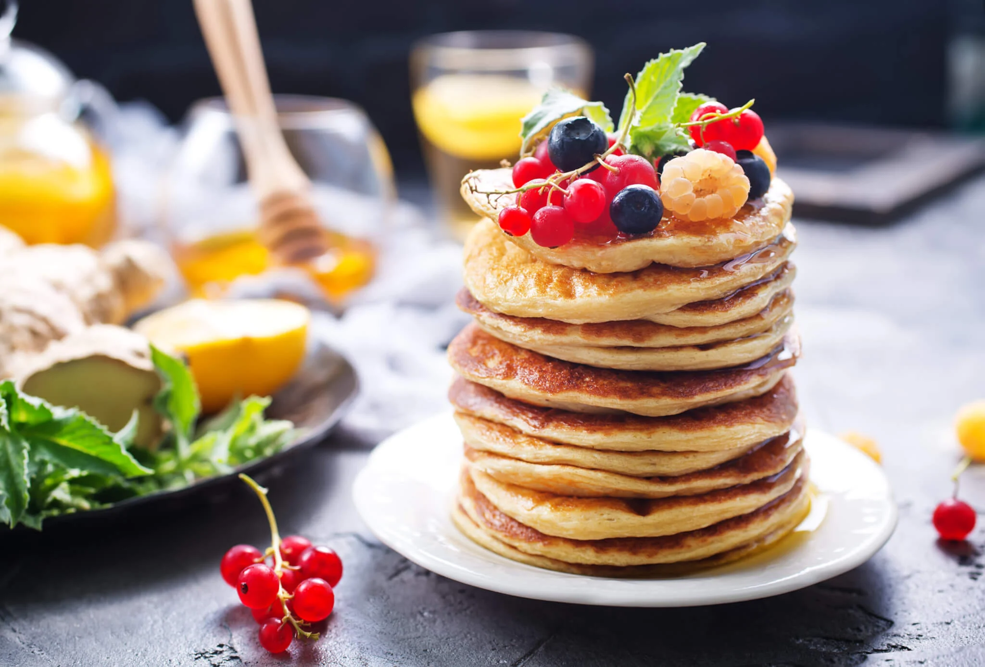
Pancake day is always on Tuesday in February
or in March. It is the day before Ash Wednesday,
the start of Lent.
Lent is a period of 40 days before
Easter when people often give up or stop eating
things that are bad for them, like chocolate and
fast food.
At the end of Lent is Easter.
Easer takes place on a different date each year
because it depends on the moon.

Slide 6
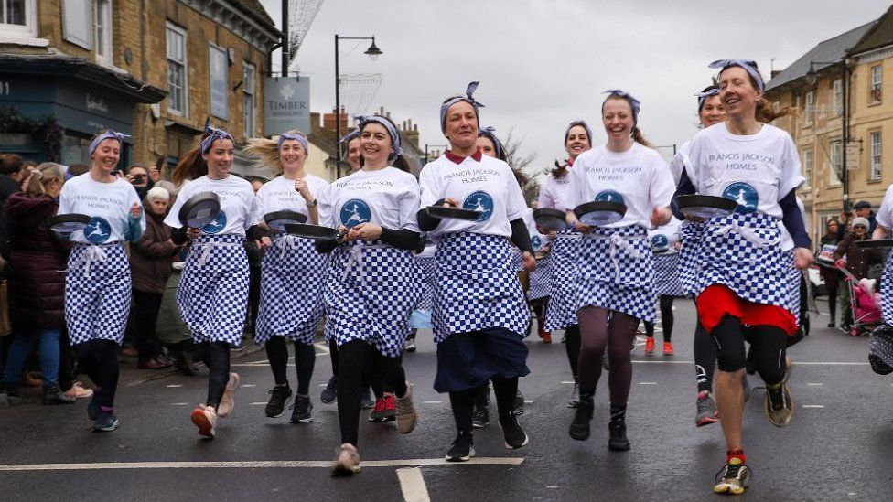
Pancake Race

Slide 7
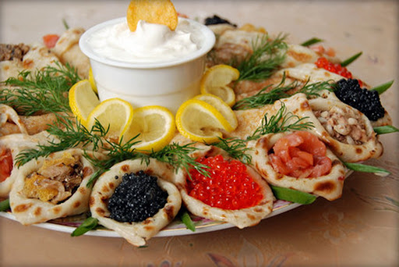
What do you like pancakes with?

Slide 8


