Slide 1


Slide 2
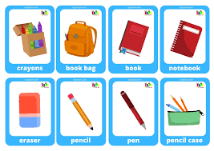
School things

Slide 3
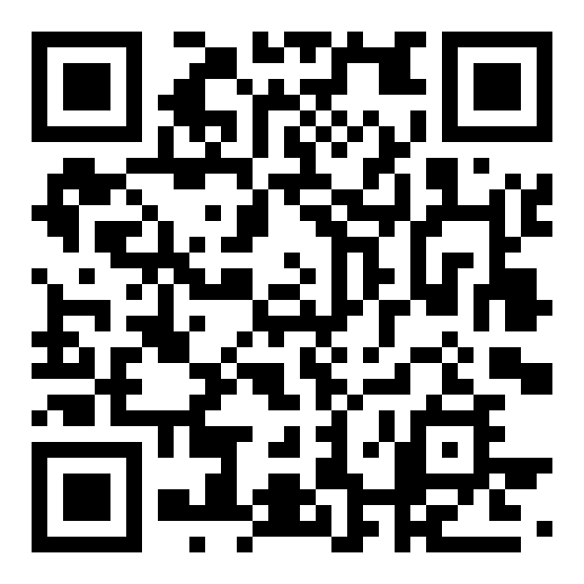
What’s this? Match.

Slide 4
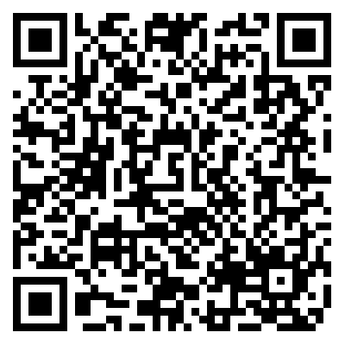
Watch the video

Slide 5
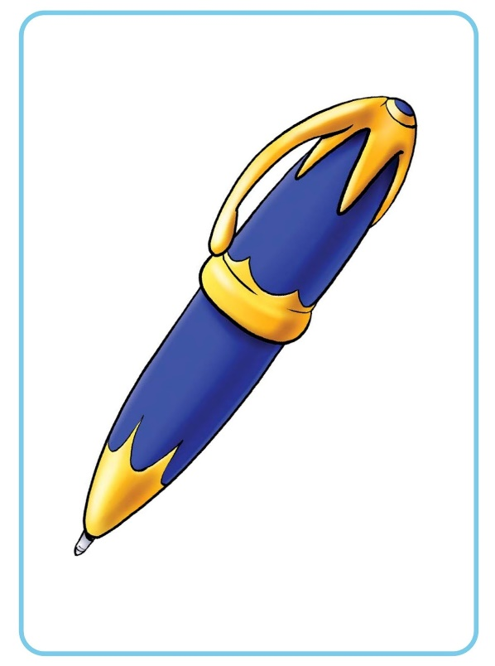
Long form
I have got – Я маю
I have got a pen.-
Я маю ручку.

Slide 6

Short form
Have got ‘ve got
I’ve got a pen.

Slide 7

I’ve got a pencil.

Slide 8

I’ve got a book.

Slide 9
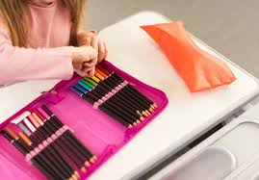
I’ve got a pencil case.

Slide 10
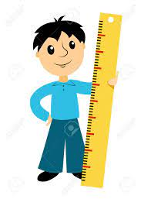
I’ve got a ruler.

Slide 11
Negative
Have
not
got
haven’t got

Slide 12

I haven’t got a pen.

Slide 13

I haven’t got a pencil.

Slide 14
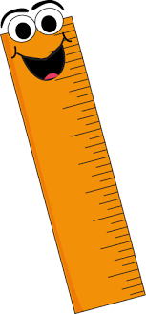
I haven’t got a ruler.

Slide 15
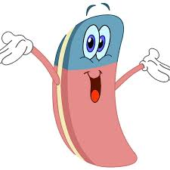
I haven’t got an eraser.

Slide 16
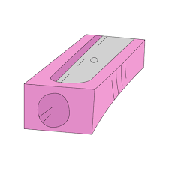
I haven’t got a sharpener .

Slide 17

Question
Have
you
got
?
Have you got a pen?

Slide 18
Short answer
Yes, I have.
No, I haven’t.

Slide 19
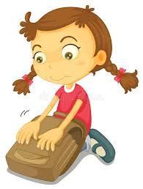
Have you got a school bag?
Yes, I have.

Slide 20

Have you got 5 books?
No, I haven’t.

Slide 21

Have you got a pencil case?
No, I haven’t.

Slide 22
Have you got a ruler?
Yes, I have.

Slide 23
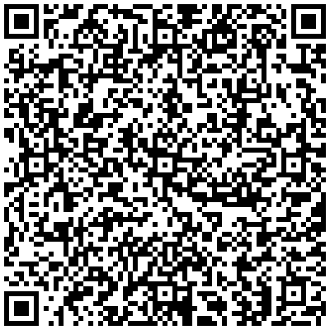
Let’s practice!

Slide 24
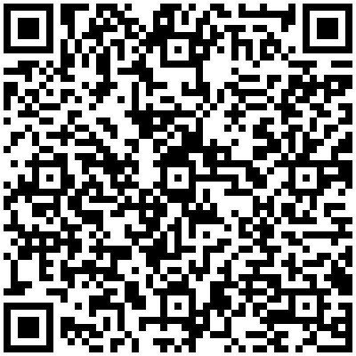
Let’s practice!

Slide 25

Well done!

Slide 26
Sites
https://learningapps.org/11313177
2) https://www.youtube.com/watch?v=maP-Z3ypoQI&t=12s
3)https://www.liveworksheets.com/worksheets/en/English_as_a_Second_Language_(ESL)/School_objects/School_objects_-_Have_you_got...$_ma1297552jf
4) https://create.kahoot.it/details/15f9deea-ce43-456e-be7f-84b64e7ff7eb

