Slide 1

Happy Birthday!
Letters «Ee,Ff,Gg,Hh»
Підготувала: Руденко Л.В

Slide 2

What is it?
a cake

Slide 3

What is it?
a balloon

Slide 4

What is it?
a candle

Slide 5

What is it?
a star

Slide 6

What is it?
a present

Slide 7




Letters

Slide 8


Slide 9

E e
an elephant

Slide 10


F f
a fish
a fox

Slide 11

G g
a goose

Slide 12
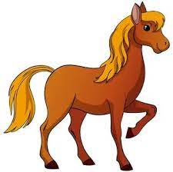
H h
a horse

Slide 13


Slide 14

Bye!

