Slide 1


Знайомство з літерами
«Сс», «Dd»
Підготувала:Руденко Л.В

Slide 2

HELLO!
HOW ARE YOU ?

Slide 3
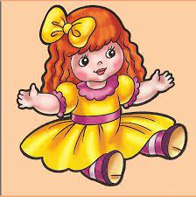
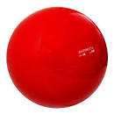
WHAT IS IT?
It is a doll
It is a ball

Slide 4

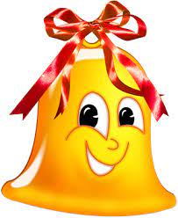
WHAT IS IT?
It is a plane
It is a bell

Slide 5
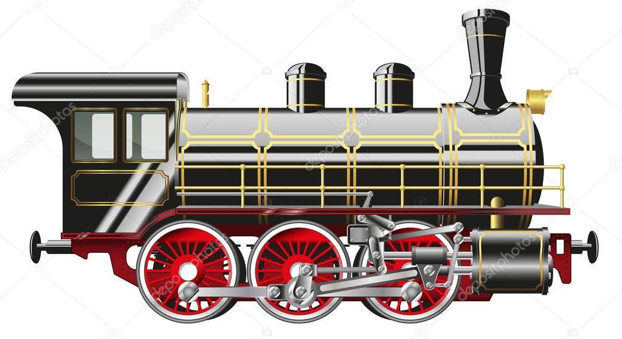

WHAT IS IT?
It is a train
It is a kite

Slide 6
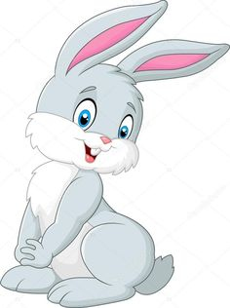
WHAT IS IT?
It is a bunny

Slide 7
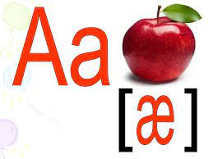
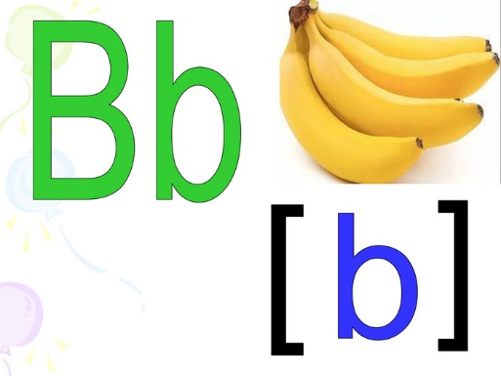
Letter Aa, Bb

Slide 8
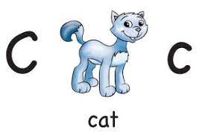
Letter Cc

Slide 9
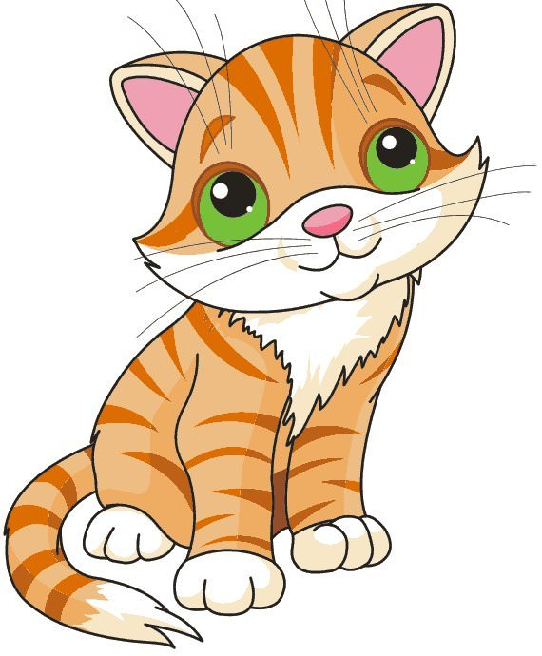
Letter Cc
A cat

Slide 10
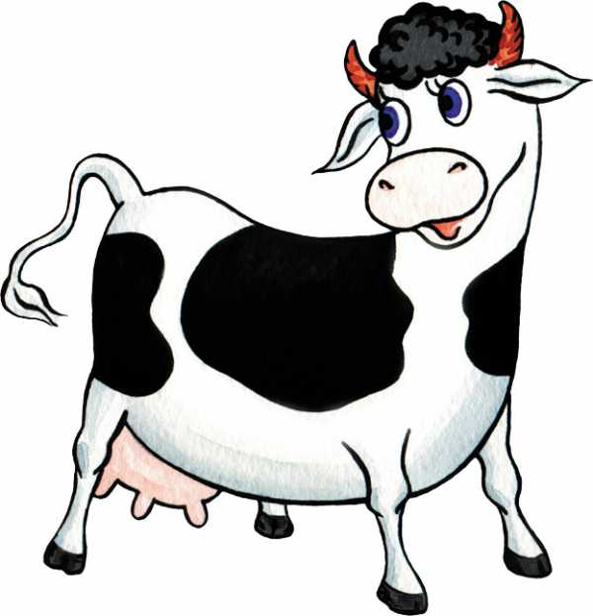
Letter Cc
A cow

Slide 11
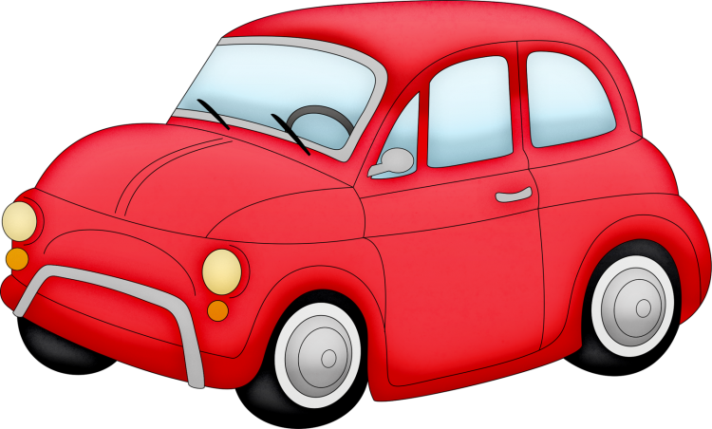
Letter Cc
A car

Slide 12
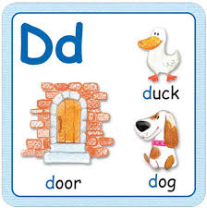
Letter Dd

Slide 13
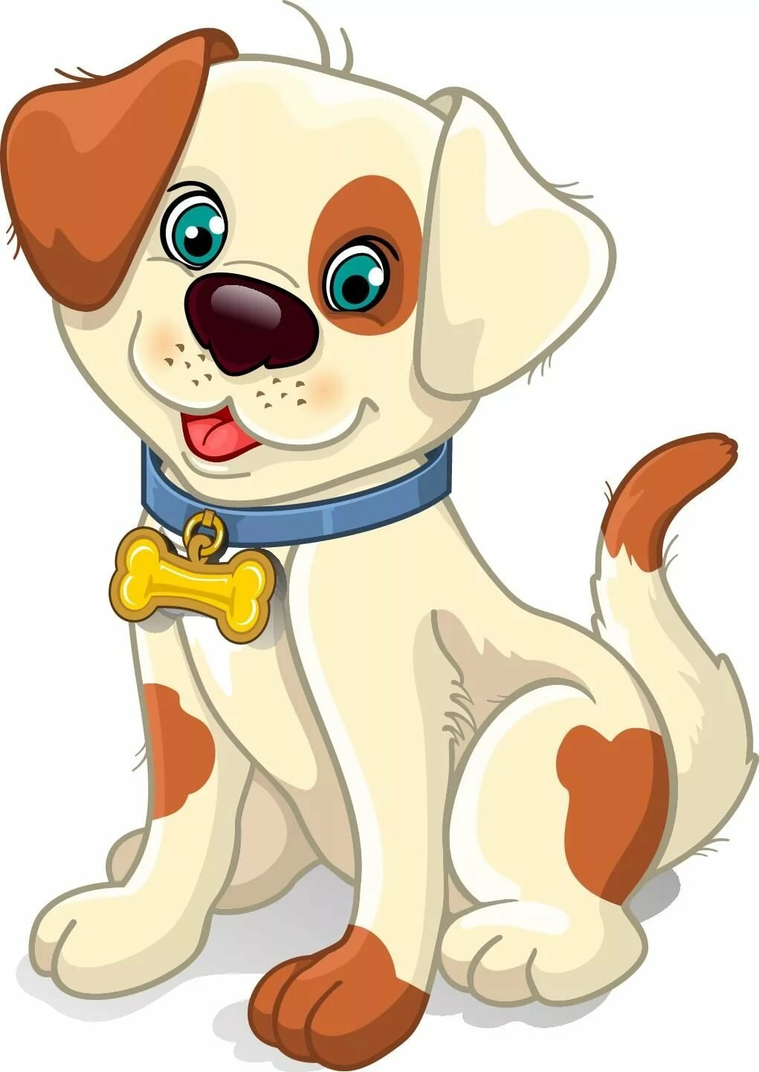
Letter Dd
A dog

Slide 14
Letter Dd
A duck

Slide 15
Letter Dd
A doll

Slide 16


Slide 17
Bye!

