Slide 1
Would you
rather?
Image by Freepik

Slide 2
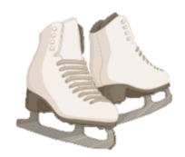
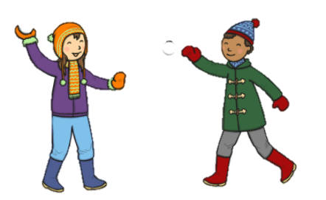
Would you rather…
… go skating?
or
… play snowballs?
Image by Freepik

Slide 3
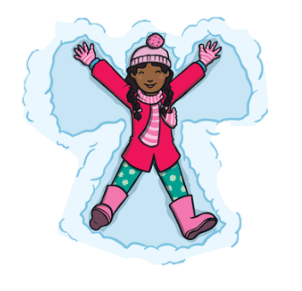
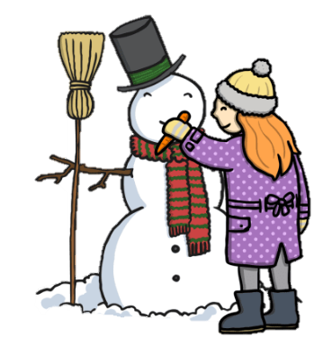
Would you rather…
… make a snow angel?
or
… make a snowman?
Image by Freepik

Slide 4
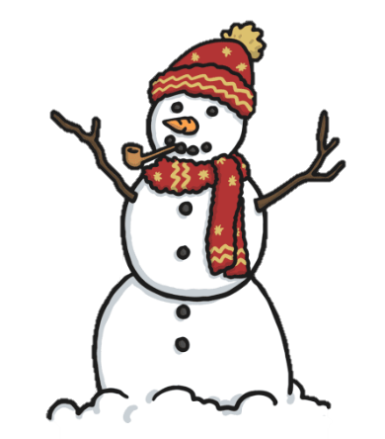
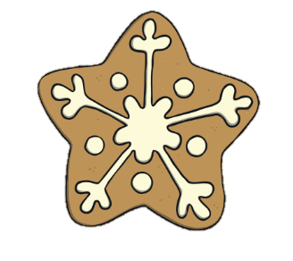
Would you rather…
… make a very big snowman?
or
… make a big snowflake cookie?
Image by Freepik

Slide 5
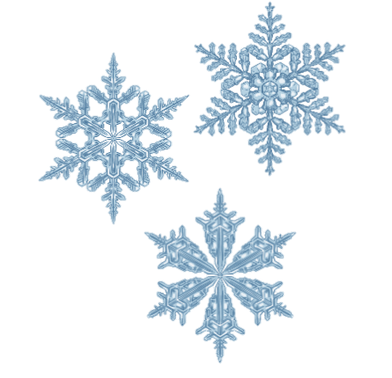
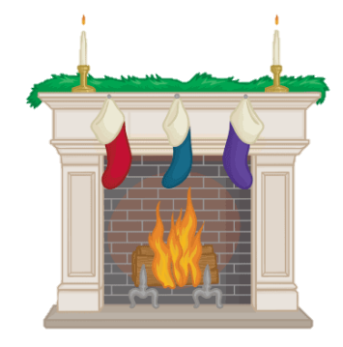
Would you rather…
… look at snowflakes?
or
… look at a fireplace?
Image by Freepik

Slide 6
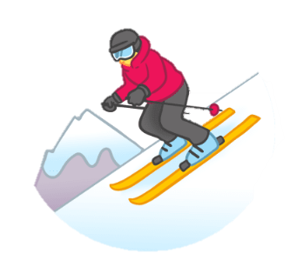
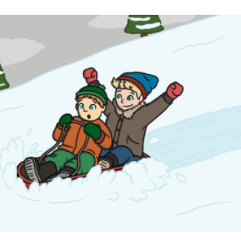
Would you rather…
… go skiing?
or
… go sledding?
Image by Freepik

Slide 7
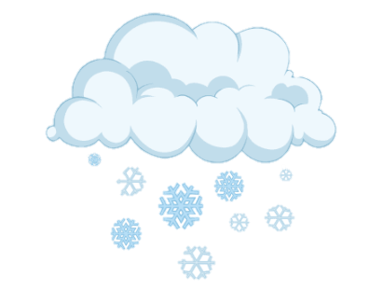
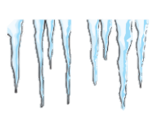

Would you rather…
… eat snow?
or
… lick an icicle?
Image by Freepik

