Slide 1
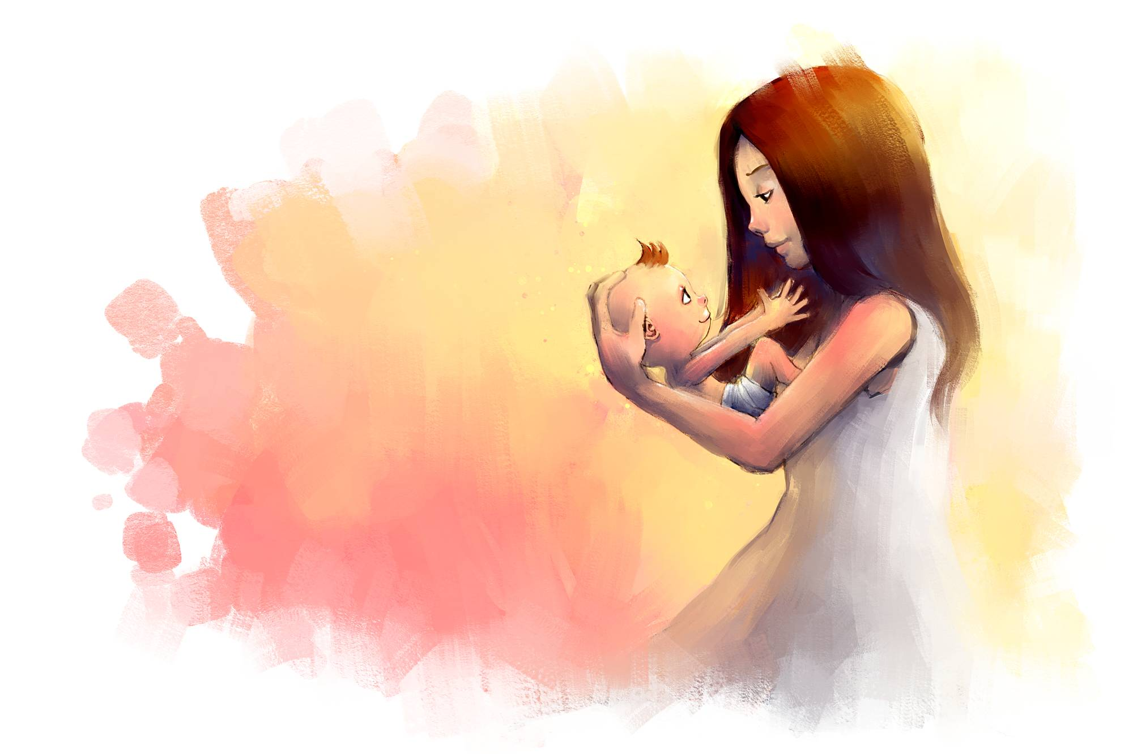

Slide 2

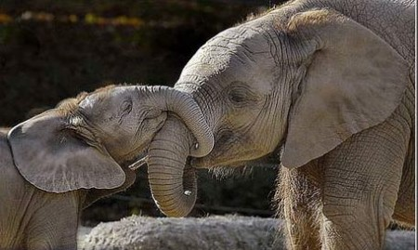
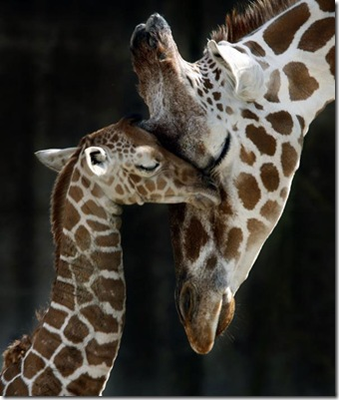
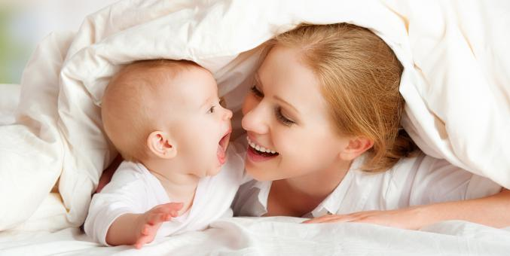
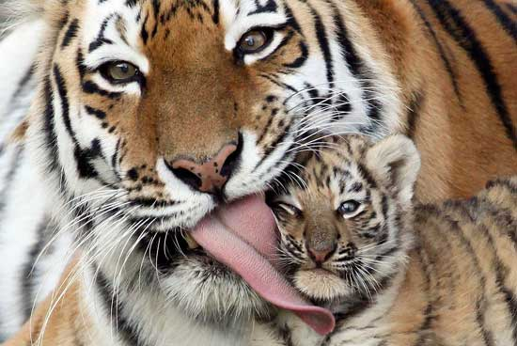
What family member do I mean?

Slide 3
[ ð ]
Is my grandmother’s mother my mother’s great grandmother?

Slide 4
Are these sentences True or False?
T
We celebrate Mother’s Day to say thanks to all moms.
In different countries you will celebrate this holiday on the same days.
3. In England Mother’s Day is always in summer and on Monday.
4. On Mother’s Day children give their mothers cards and presents.
5. It is a national holiday.
6. All families like to stay at home on Mother’s Day.
7. All women try to be nice and happy on this day.
F
F
T
F
F
T

Slide 5
Listen to the text and then answer the questions.
1. What day of the week is it?
2. What’s Mum having for breakfast?
3. Has she got a rose?
4. Who’s giving her a present?
5. What’s the present?

Slide 6
Let’s play a memory game.
It’s Mother’s Day
and Mum has got a rose and…

Slide 7
Look at the board and translate the words:
beautiful, nice, clever, pretty, kind,
shy, strong, creative, active,
hard-working, talkative, brave,
funny, fantastic

Slide 8
And now make a sentence
and write it on the flower.
I love my mother because
she is…
(beautiful, nice, clever, pretty, kind,
shy, strong, creative, active,
hard-working, talkative, brave,
funny, fantastic)

Slide 9
Nem ekam sesuoh,
Nemow ekam semoh.
Меn make houses,
women make homes.

