Slide 1
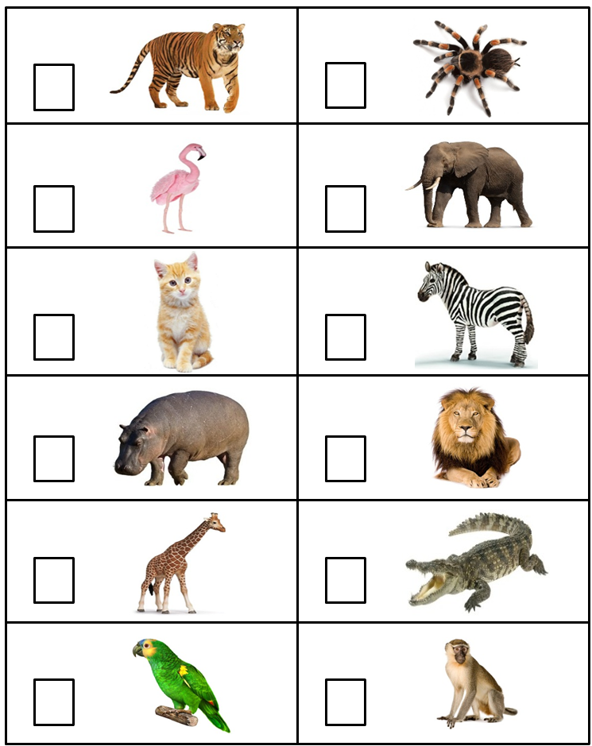
Appendix 3 «Listen and Tick»
Tick and say

