Slide 1
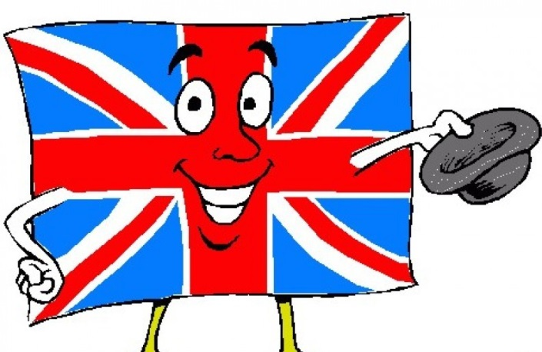
You are welcome to our quiz

Slide 2


Slide 3


Slide 4
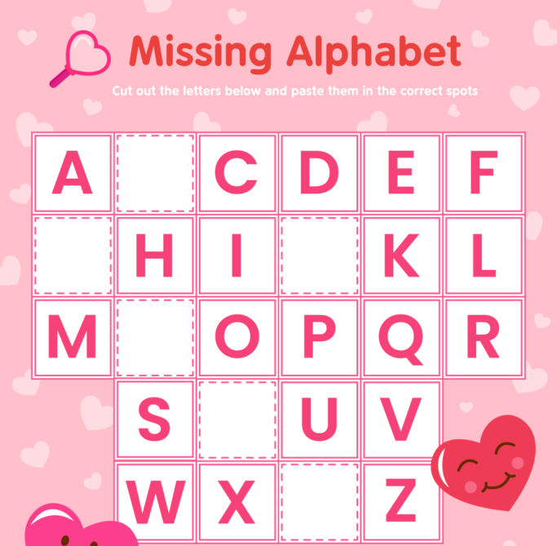
Warming up
Let’s refresh our knowledge of the English alphabet. Your task is to fill in the alphabet with the missing letters.
B
G
J
N
T
Y

Slide 5
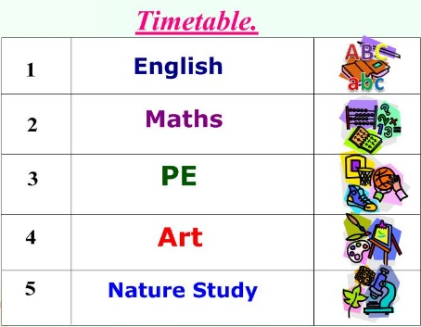
Let’s imagine one of our typical school days. What subjects do we have today?
Read and name the subject.
In this subject we watch videos, sing songs, play games, talk to our friends and read stories in a foreign language. We don't swim.
In this subject we do sums and write numbers. We don't jump.
In this subject we run, jump, skip and play football.
In this subject we draw pictures of our friends, teachers and pets. We don't jump.
In this subject we learn interesting facts about animals and plants.
English
Maths
PE
Art
Nature Study

Slide 6
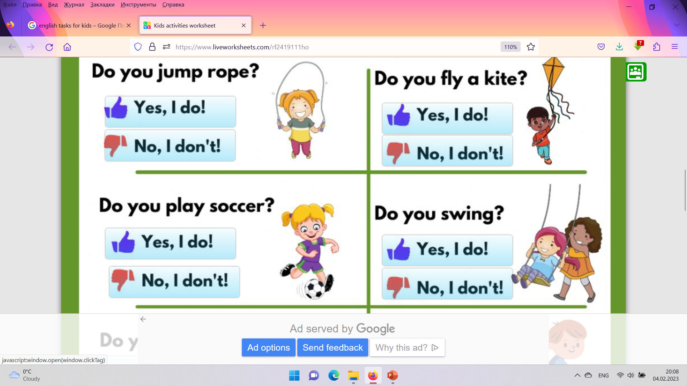
Our 1st lesson is English
Answer the questions about yourselves
by reacting in the zoom
chat room.

Slide 7
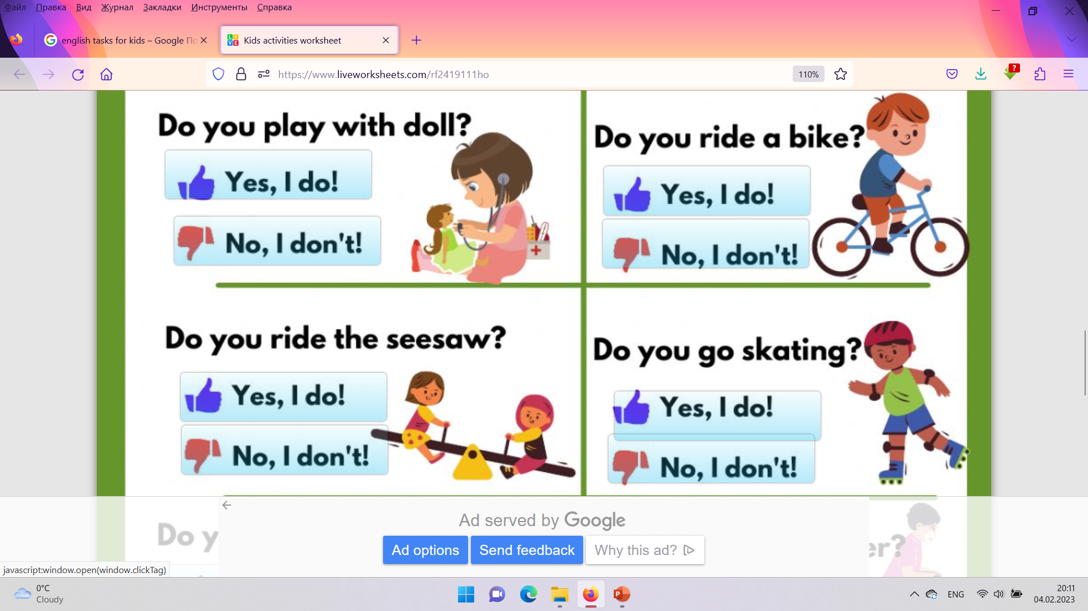
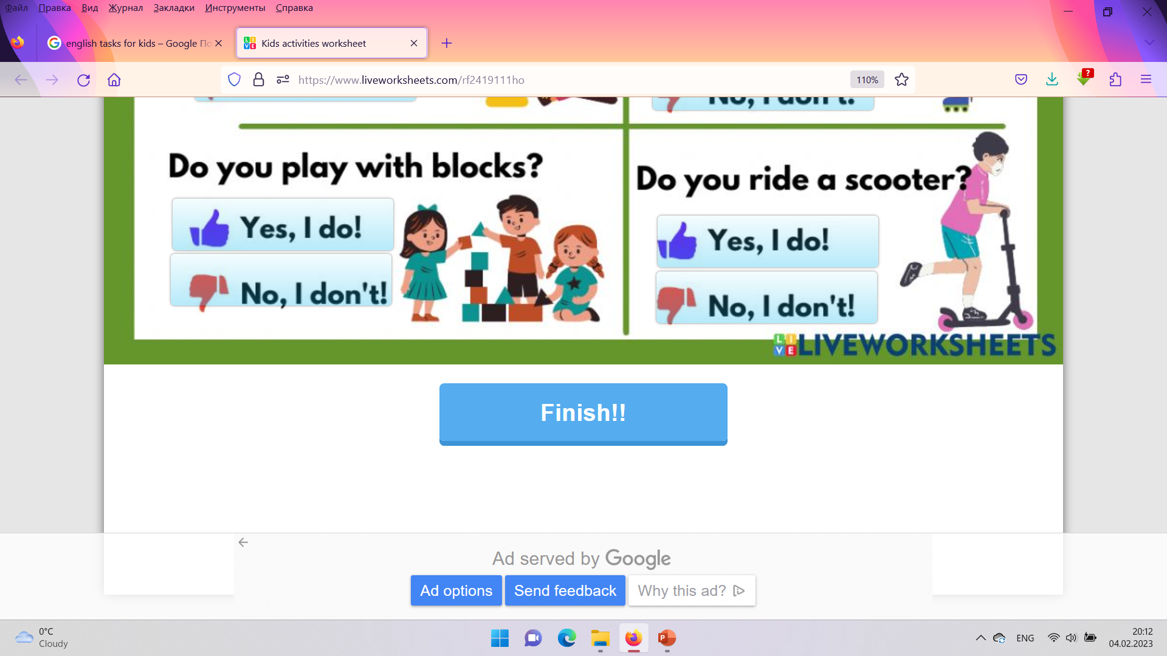

Slide 8
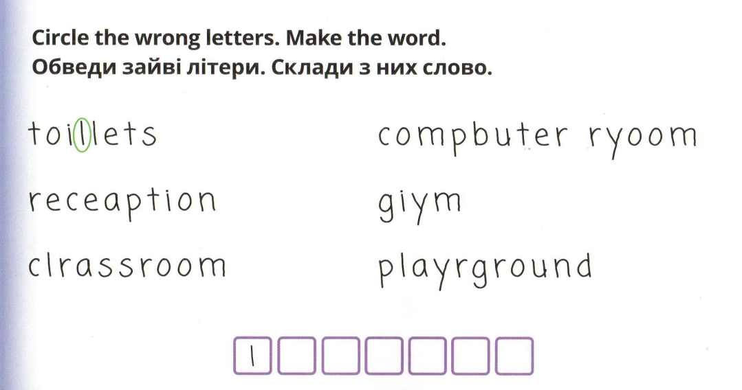

l
a
r
b
i
r
L i b r a r
y

Slide 9

Our 2nd lesson is Maths.
Read and do some sums.
One + eleven =
12
Twenty - five =
15
9
Eleven - two =
9
Two + seven =
Three + ten =
13
Fifteen – seven =
8
16
Fourteen – seven =
7
Four + twelve =
Five + five =
10
Eight – three =
5
Six + fourteen =
20
Thirteen – three =
10
Seven + eight =
15
Ten - nine =
1

Slide 10

Our 3rd lesson is PE
Let’s relax. Feel free to move.

Slide 11
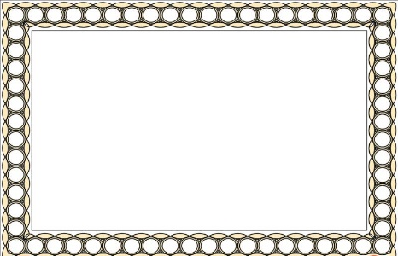
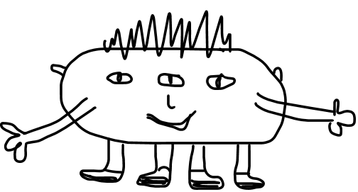
Our 4th lesson is Art
Take a piece of paper and a pencil. Draw a picture using the instructions:
Draw a big horizontal oval.
It’s got three eyes, one nose, one mouth and
two ears.
It’s got short hair. Its hair is black.
It’s got two long arms.
It’s got two hands.
It’s got four short legs. They are green.
It’s got four black feet.
What is it?
It’s a monster?

Slide 12
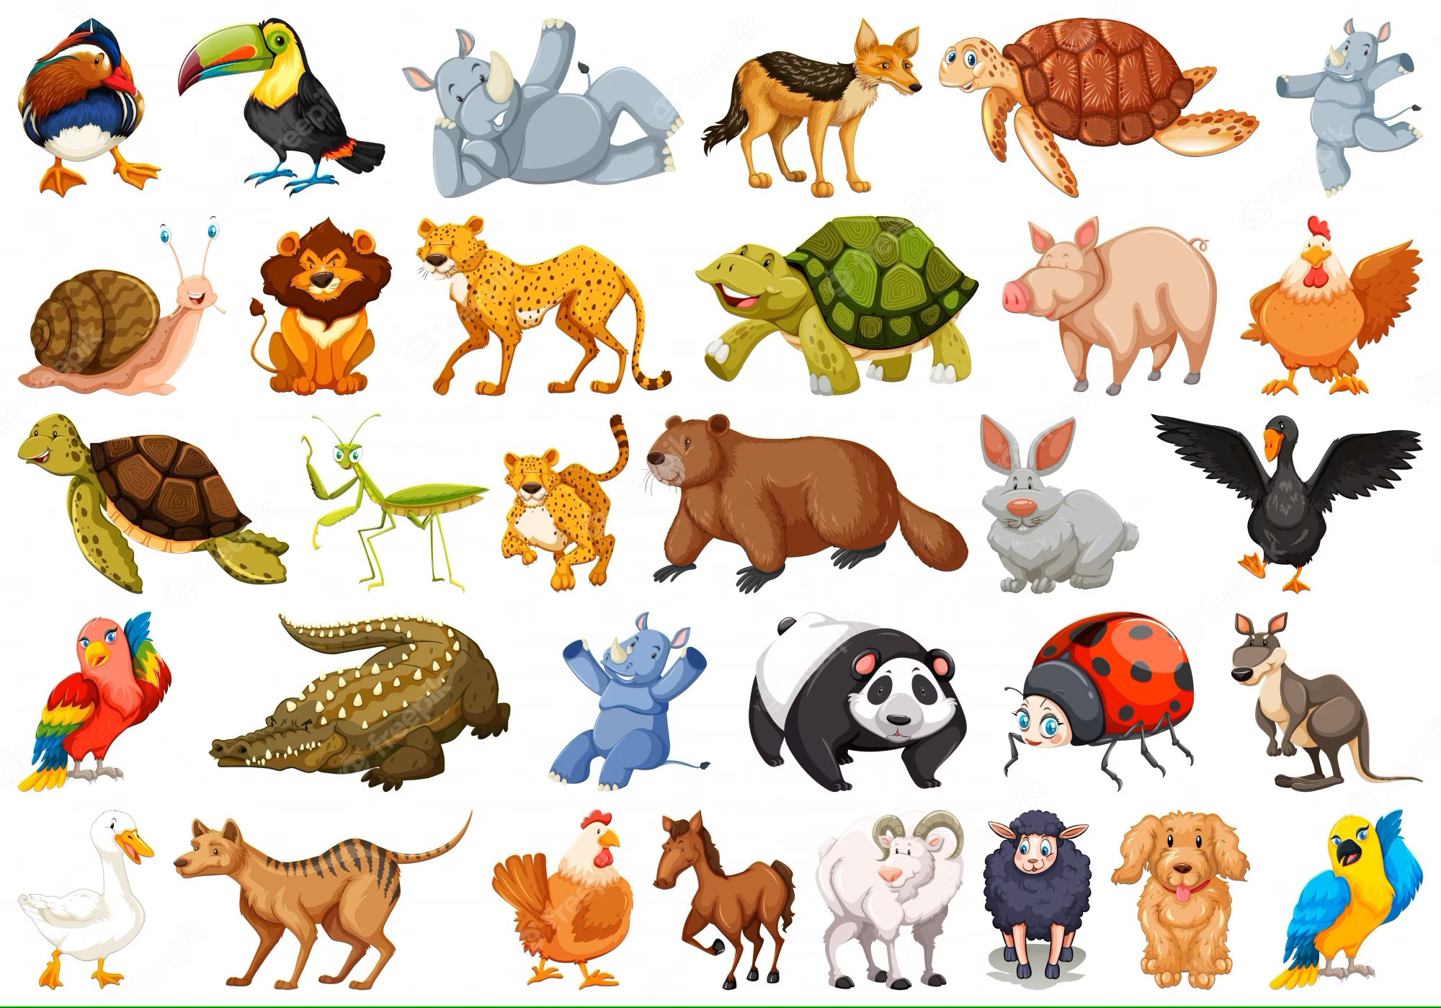
Our 5th lesson is Nature Study
Let’s watch the video “What can you see?” (Animals). Then guess the riddles.

Slide 13
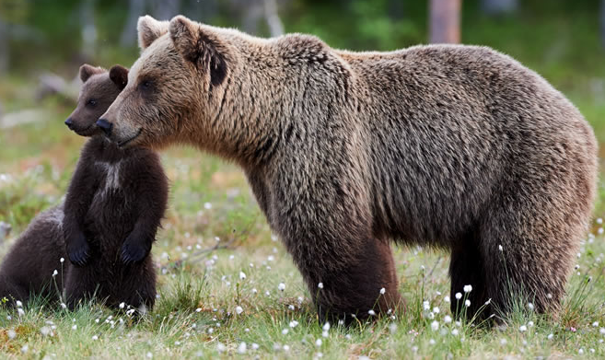
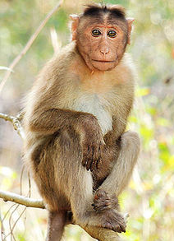
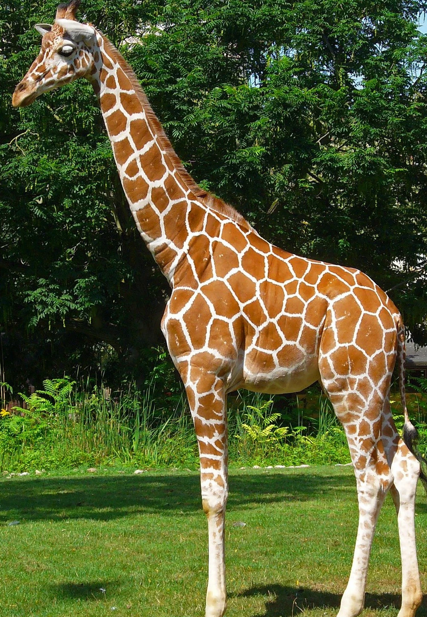
I am yellow and brown.
I eat leaves.
I have a very long neck.
I live in Africa.
What am I?
I can climb trees.
I look like a human.
I like bananas.
I like playing.
What am I?
I am very big.
I eat fish and berries.
I have a little tail and four legs.
I live in the woods.
What am I?

Slide 14
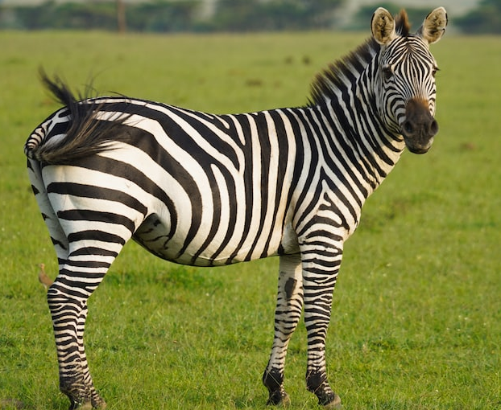
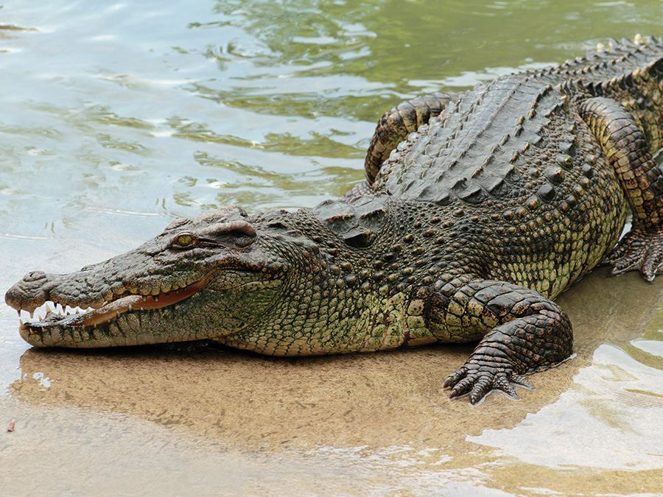
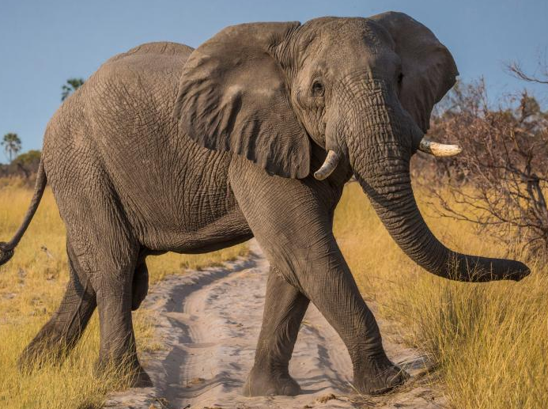
I eat a lot of grass.
I look like a horse.
I have black and white stripes.
I have four legs.
What am I?
I live in rivers and lakes.
I eat fish and birds.
I have four legs and a long tail.
I have a lot of teeth.
What am I?
I have four legs.
I have big ears.
I have a trunk.
I am very big.
What am I?

Slide 15
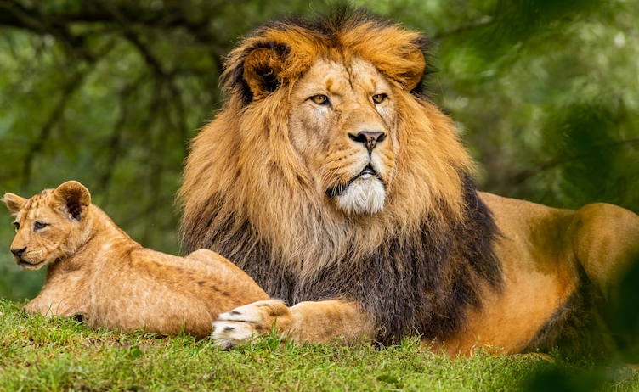
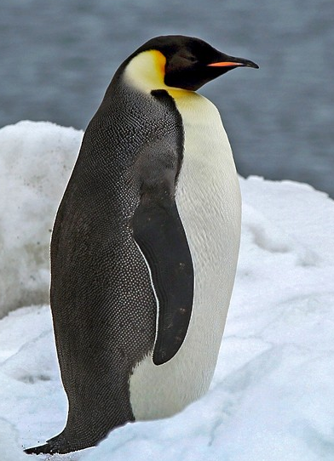
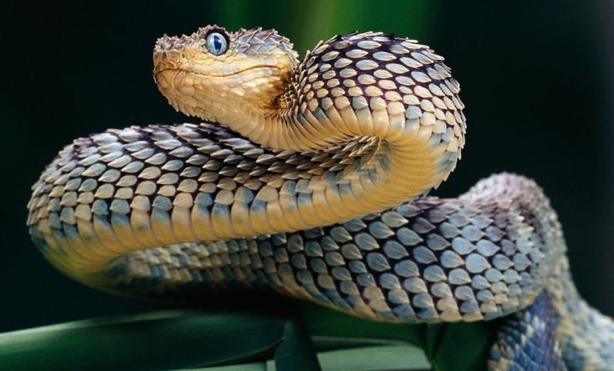
I am long.
I have no legs.
I can hiss.
I have a forked tongue.
What am I?
I am a bird.
I have two wings.
I can swim in the water.
I can’t fly in the air.
What am I?
I can run fast.
I have sharp teeth.
I have long hair round my neck.
I am the King of animals.
What am I?

Slide 16


Slide 17


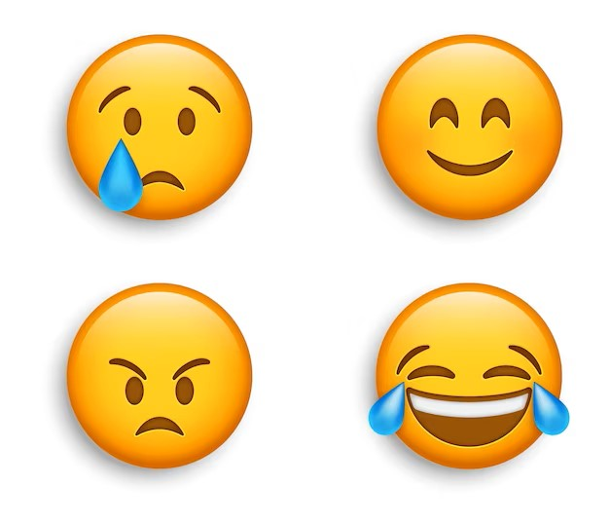
Feedback
Was the quiz interesting for you?
Give your reactions, please!
Dull….
Super!
Bored….
Fantastic!

Slide 18


