Slide 1

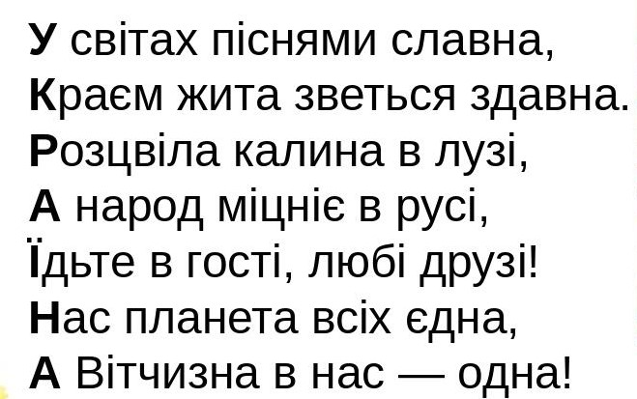

Slide 2
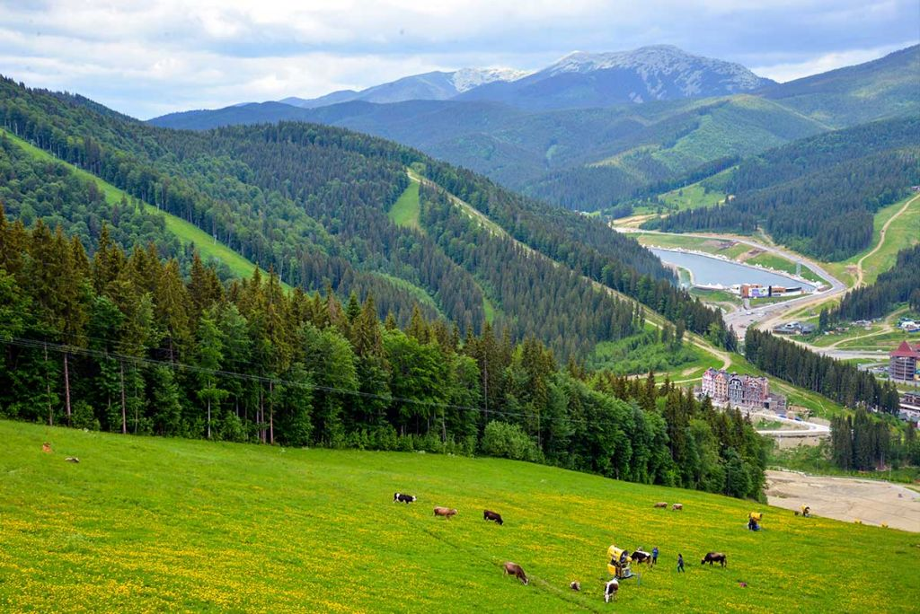
:6
-40
-150
*10
*100
*80
:1000
+61
*50
:100
* 1
+ 120
580

Slide 3


