Slide 1


Slide 2
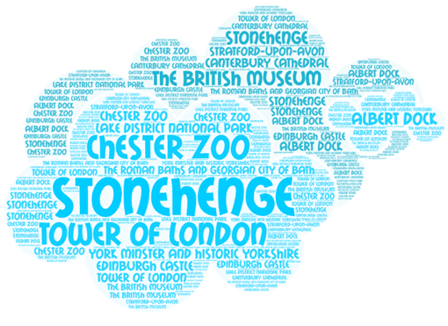

Slide 3
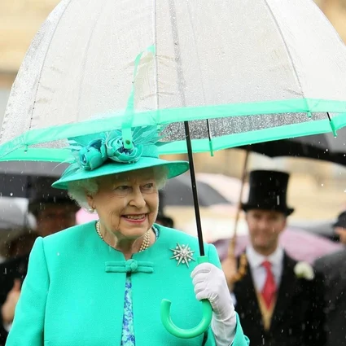

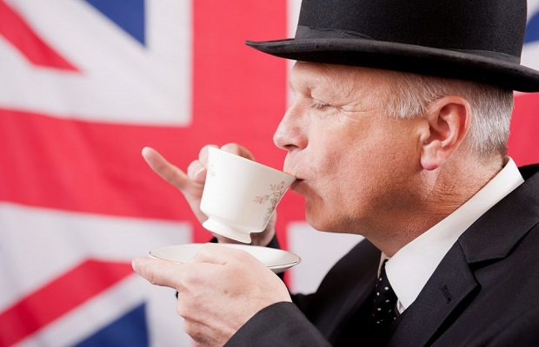
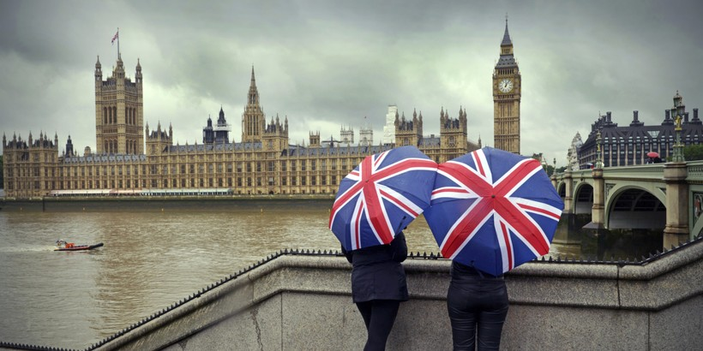


Slide 4
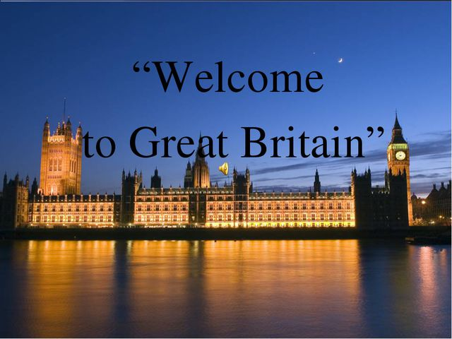

Slide 5
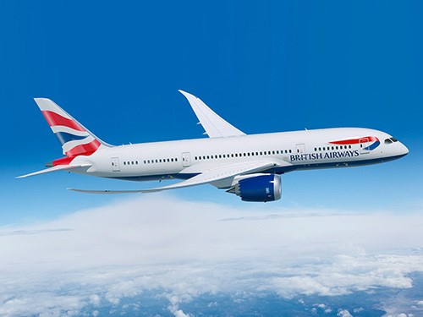

5-B Airlines
https://drive.google.com/file/d/1Jo-yN-QawzOPTYFhMoOq4R_S5lnRsbU7/view?usp=sharing

Slide 6
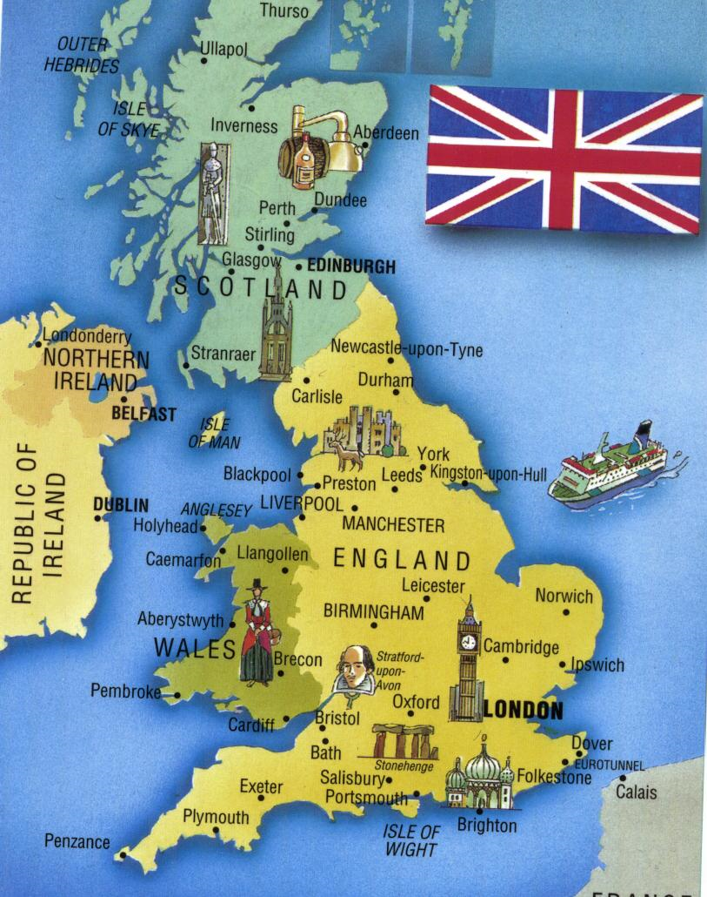
https://www.youtube.com/watch?v=RvDIZoQLgIE&feature=youtu.be

Slide 7
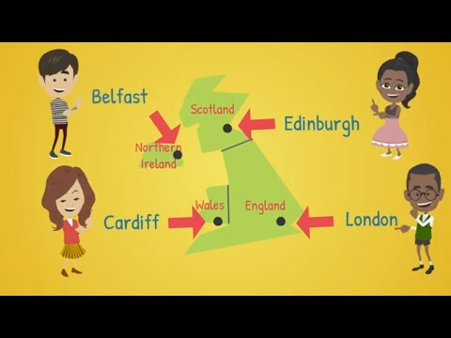

Slide 8
United Kingdom [ju:,naitid ‘kiŋdəm] Сполучене Королівство
England [‘iŋglənd] Англія
Scotland [‘skotlənd] Шотландія
Wales [weilz] Уельс
Northern Ireland [,no:ðn ‘aiələnd] Північна Ірландія

Slide 9
Edinburgh [‘edinbərə] Единбург
Cardiff [‘ka:dif] Кардіфф
Belfast [,bel’fa:st] Белфаст
London ['lʌndən] Лондон
https://www.youtube.com/watch?v=RvDIZoQLgIE&feature=youtu.be

Slide 11


Slide 12


Slide 13


Slide 14


Slide 15


Slide 17
Read the sentences and say True or False.
The United Kingdom (The UK) of Great Britain and Northern Ireland is situated in Europe.
(T)
2. The UK consists of 5 parts.
(F)
3. London is the capital of Great Britain.
(T)
4. Edinburgh is the capital of England.
(F)
5. Cardiff is the capital of Scotland.
(F)
6. Belfast is the capital of Northern Ireland.
(T)
7. British people don't have a lot of traditions.
(F)
8. Britains like talking about the weather.
(T)
9. They enjoy drinking coffee with milk.
(F)

Slide 18
Join the name of the country with its capital.
https://learningapps.org/display?v=pias3z0fa21

Slide 19


Slide 20
5-B Airlines

Slide 21

Friday, the twenty-sixth of February
Class work

Slide 22
Conversion Table
A=1 B=2 C=3 D=4 E=5 F =6 G=7 H=8 I =9 J = 10 K = 11
L = 12 M = 13 N = 14 O = 15 P = 16 Q = 17 R = 18 S = 19
T = 20 U = 21 V = 22 W = 23 X = 24 Y = 25 Z = 26
7+7=14 (N) 19-14=5 (E) 3*3=9 (I)
20-5=15 (O) 12+6=18 (R) 20-2=18 (R)
9*2=18 (R) 2*7=14 (N) 2+3=5 (E)
11+9=20 (T) 6*2=12 (L)
16:2=8 (H) 7-6=1 (A)
12+2=14 (N)
24:6=4 (D)

Slide 23
Conversion Table
A=1 B=2 C=3 D=4 E=5 F =6 G=7 H=8 I =9 J = 10 K = 11
L = 12 M = 13 N = 14 O = 15 P = 16 Q = 17 R = 18 S = 19
T = 20 U = 21 V = 22 W = 23 X = 24 Y = 25 Z = 26
17- 12 = 19 - 16 = 32 - 30 = 24 : 2 =
7 * 2 = 15 - 14 = 25 : 5 = 3 * 5 =
21 : 3 = 9 * 2 = 3 * 4 = 30 - 16 =
9 + 3 = 3 + 1 = 5 + 1 = 48 - 44 =
20-19 = 27 : 3 = 13 - 12 = 7 + 8 =
10 +4 = 3 * 2 = 38 : 2 = 54 - 40 =
8 : 2 = 12 - 6 = 10 * 2 =

Slide 24
Conversion Table
A=1 B=2 C=3 D=4 E=5 F =6 G=7 H=8 I =9 J = 10 K = 11
L = 12 M = 13 N = 14 O = 15 P = 16 Q = 17 R = 18 S = 19
T = 20 U = 21 V = 22 W = 23 X = 24 Y = 25 Z = 26
17-12=5 (E) 19-16= 3 (C) 32-30= 2 (B) 24:2=12 (L)
7*2=14 (N) 15-14= 1 (A) 25:5= 5 (E) 3*5= 15 (O)
21:3=7 (G) 9*2= 18 (R) 3*4= 12 (L) 30-16=14 (N)
9+3=12 (L) 3+1= 4 (D) 5+1= 6 (F) 48-44= 4 (D)
20-19=1 (A) 27:3= 9 (I) 13-12= 1 (A) 7+8= 15 (O)
10+4= 14 (N) 3*2=6 (F) 38:2= 19 (S) 54-40= 14 (N)
8:2 = 4 (D) 12-6= 6 (F) 10*2= 20 (T)

Slide 25
Conversion Table
A=1 B=2 C=3 D=4 E=5 F =6 G=7 H=8 I =9 J = 10 K = 11
L = 12 M = 13 N = 14 O = 15 P = 16 Q = 17 R = 18 S = 19
T = 20 U = 21 V = 22 W = 23 X = 24 Y = 25 Z = 26
100 - 81 = 9 + 3 = 76 - 71 = 97 - 95 = 43 - 20 =
57 - 54 = 99 - 98 = 40 : 10 = 14 + 7 = 54 - 53 =
30 : 2 = 2 * 7 = 3 * 3 = 9 * 2 = 36 : 3 =
4 * 5 = 24 : 6 = 7 * 2 = 4 + 3 = 40 : 8 =
76 - 68 = 11 + 8 =

Slide 26
Conversion Table
A=1 B=2 C=3 D=4 E=5 F =6 G=7 H=8 I =9 J = 10 K = 11
L = 12 M = 13 N = 14 O = 15 P = 16 Q = 17 R = 18 S = 19
T = 20 U = 21 V = 22 W = 23 X = 24 Y = 25 Z = 26
100 - 81 = 19 (S) 9 + 3 = 12 (L) 76 - 71 = 5 (E) 97 - 95 = 2 (B) 43 - 20 = 23 (W)
57 - 54 = 3 (С) 99 - 98 = 1 (A) 40 : 10 = 4 (D) 14 + 7 = 21 (U) 54 - 53 = 1 (A)
30 : 2 = 15 (O) 2 * 7 = 14 (N) 3 * 3 = 9 (I) 9 * 2 = 18 (R) 36 : 3 = 12 (L)
4 * 5 = 20 (T) 24 : 6 = 4 (D) 7 * 2 = 14 (N) 4 + 3 = 7 (G) 40 : 8 = 5 (E)
76 - 68 = 8 (H) 11 + 8 = 19 (S)

Slide 27
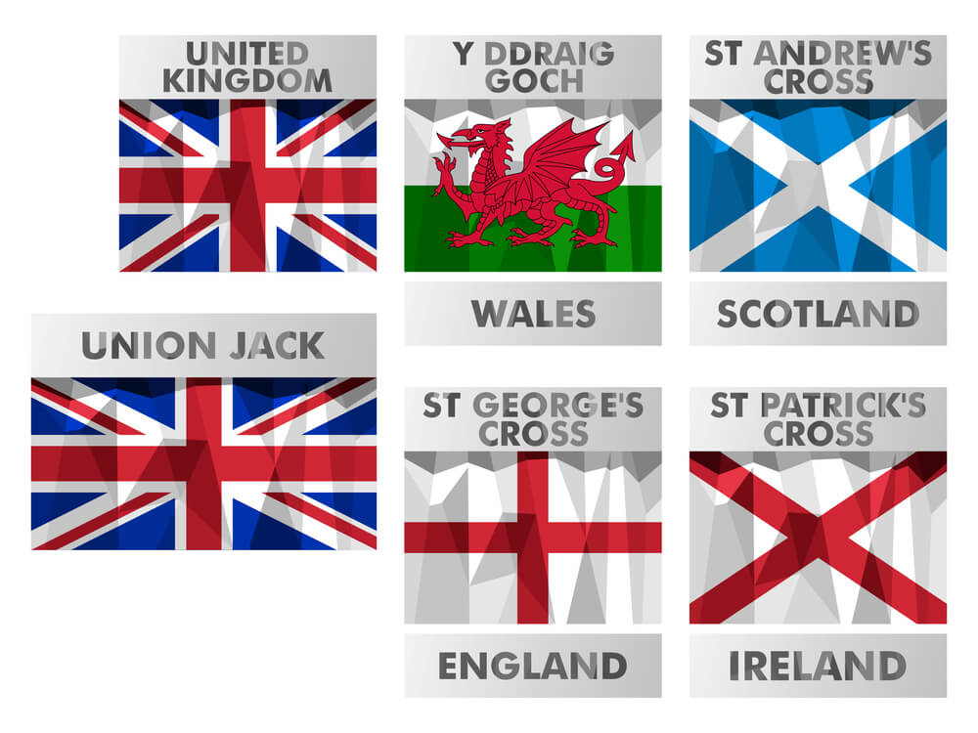
Join the name of the country with its flag.
https://learningapps.org/display?v=p57d98yek21

Slide 28
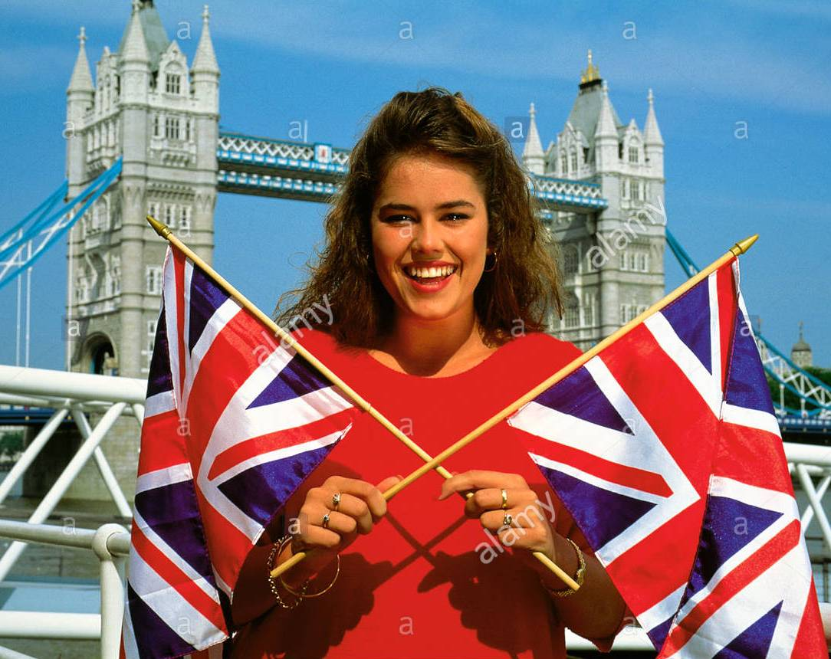
Look and say
Mary / London
Mary is from London.
London is the capital
of Great Britain.

Slide 29
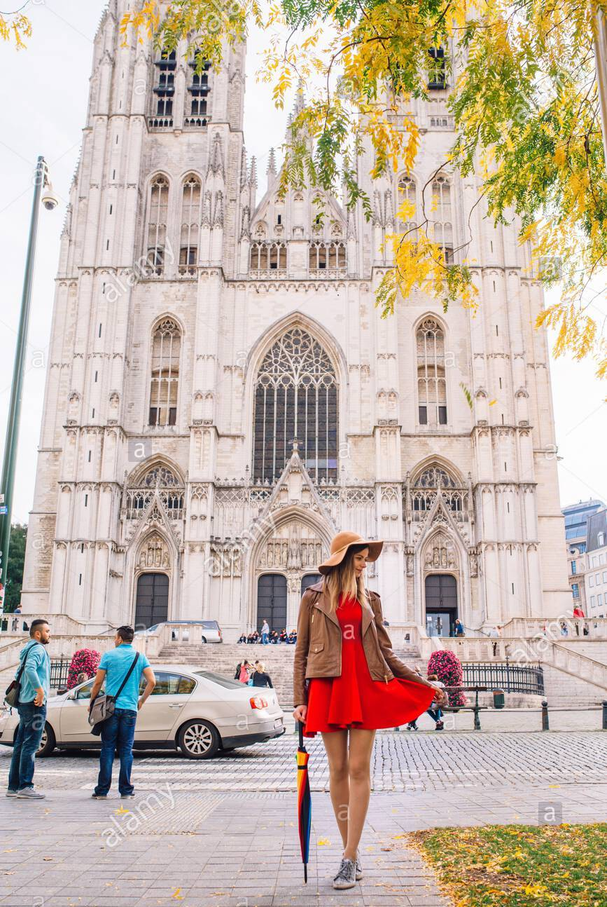
Look and say
Jane / Belfast

Slide 30
Look and say
Jane / Belfast
Jane is from Belfast.
Belfast is the capital
of Northern Ireland.

Slide 31


Look and say
Ben / Edinburgh

Slide 32
Look and say
Ben / Edinburgh
Ben is from Edinburgh.
Edinburgh is the capital
of Scotland.

Slide 33
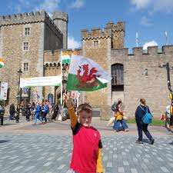
Look and say
Nick / Cardiff

Slide 34
Look and say
Nick / Cardiff
Nick is from Cardiff.
Cardiff is the capital
of Wales.

Slide 35

Do you like our lesson?
What are your emotions after the lesson?

Slide 36



EXCELLENT
OK
BAD

Slide 37

1) learn new words by heart;
2) read and translate the text in ex.3 at page 123;
3) paint the flag of the country you liked best of all
(за бажанням).

Slide 38


Slide 39
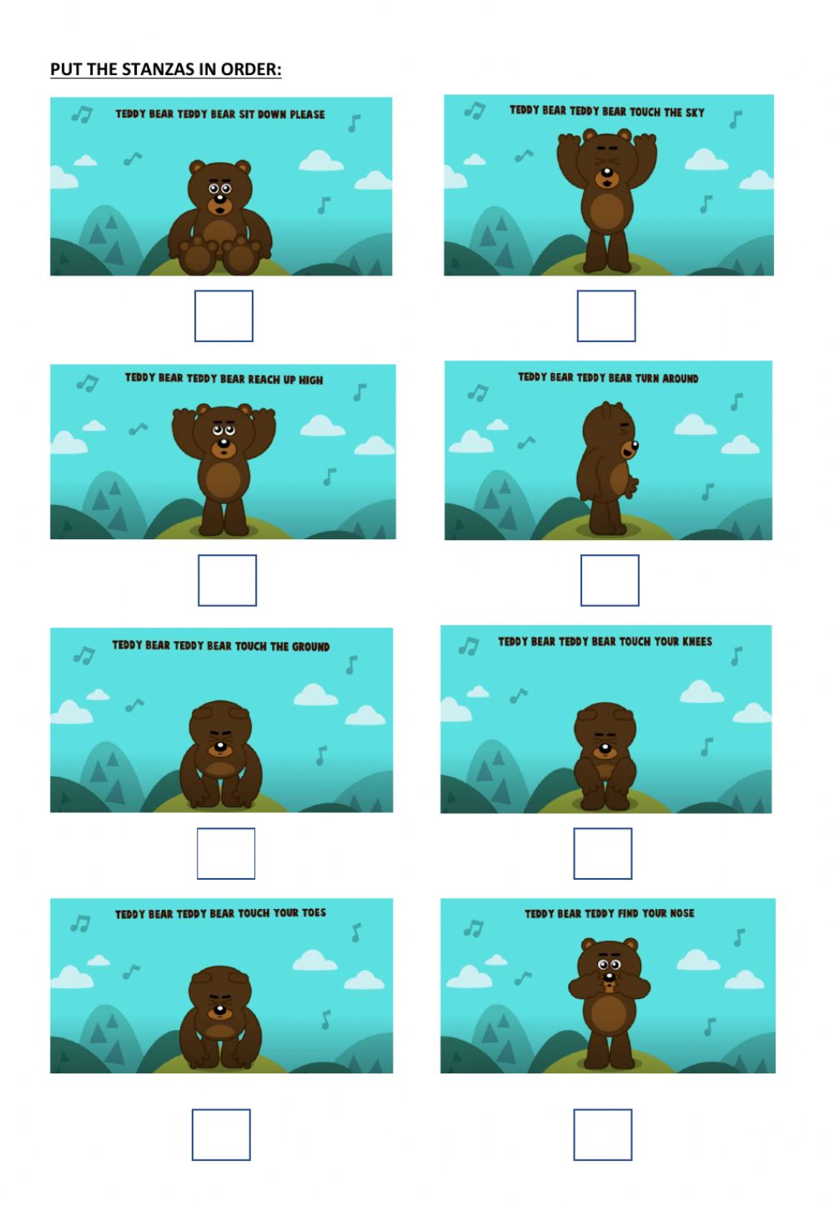

https://www.youtube.com/watch?v=76wc4xdgzGk

Slide 40
Great Britain
The United Kingdom (The UK) of Great Britain and Northern Ireland is situated in Europe. The UK consists of 4 parts.
They are England, Scotland, Wales and Northern Ireland. Each part has got its capital.
London is the capital of Great Britain. Edinburgh is the capital of Scotland. Cardiff is the capital of Wales. Belfast is the capital of Northern Ireland.
People who live in Great Britain are Britains. They are English. They all speak English, the official language of the country.
British people have a lot of traditions. They like talking about the weather. They enjoy drinking tea with milk.

