Slide 1
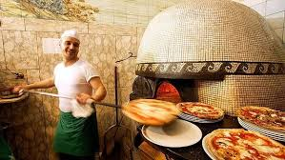
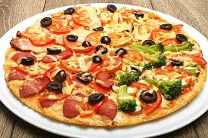
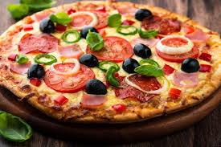
“ ДНЗ” Костянтинівське вище професійне училище
Quiz
Do you believe that…
Підготувала викладач англійської мови Данілова А.М.

Slide 2
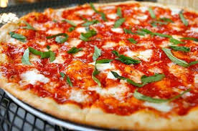
Do you believe that…
1.... in the USА there is a national pizza month?

Slide 3
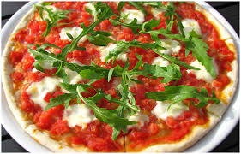
Do you believe that…
the first pizzeria in the world was opened in 1968?

Slide 4
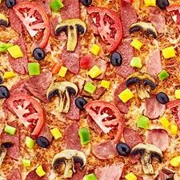
Do you believe that… the most popular ingredient of pizza – tomatoes

Slide 5
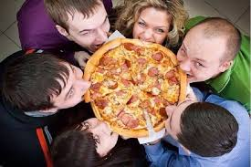
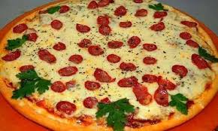
Do you believe that…
Italians are the biggest pizza eaters in Europe

Slide 6
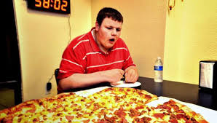
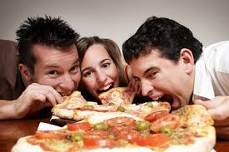
Do you believe that… pizza can reduce the risk of cancer?

Slide 7
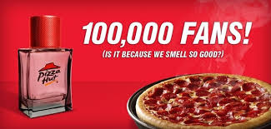
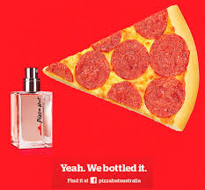
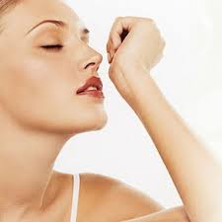
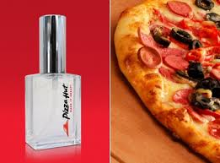
Do you believe that…
There is cosmetics with the smell of pizza?

Slide 8
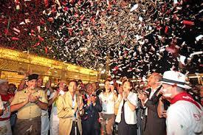
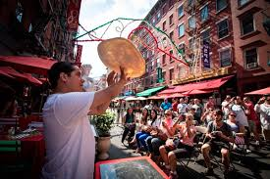
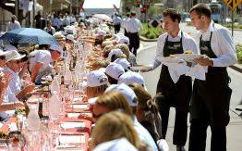
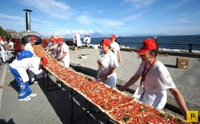
Do you believe that…
The main pizza festival in the world (pizzafest) is held in Rome?

Slide 9
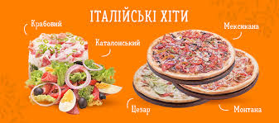
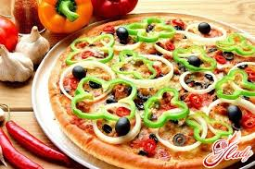
Do you believe that…
"Hawaiian pizza" was invented in Hawaii?

