Slide 1
ABC - CODE
Entertaining lesson for fifth grade students
(topics of the first semester)

Slide 2

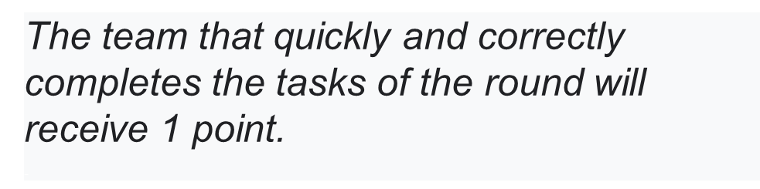

Slide 3
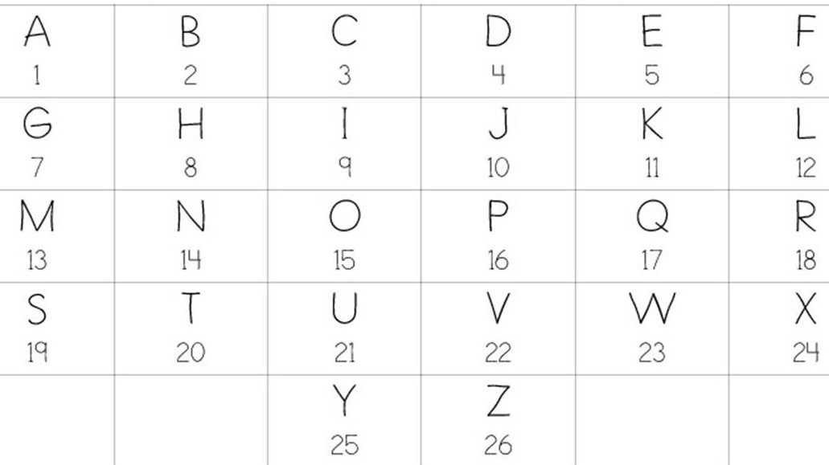
16. 18. 15.6. 5 .19. 19.9.15.14.19

Slide 4
.
you need to write as many professions as possible

Slide 5
let's guess the topic of the second round. we play again ABC-CODE:
3.12.15.20.8.5.19

Slide 6
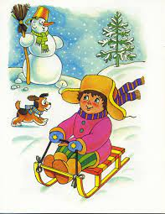

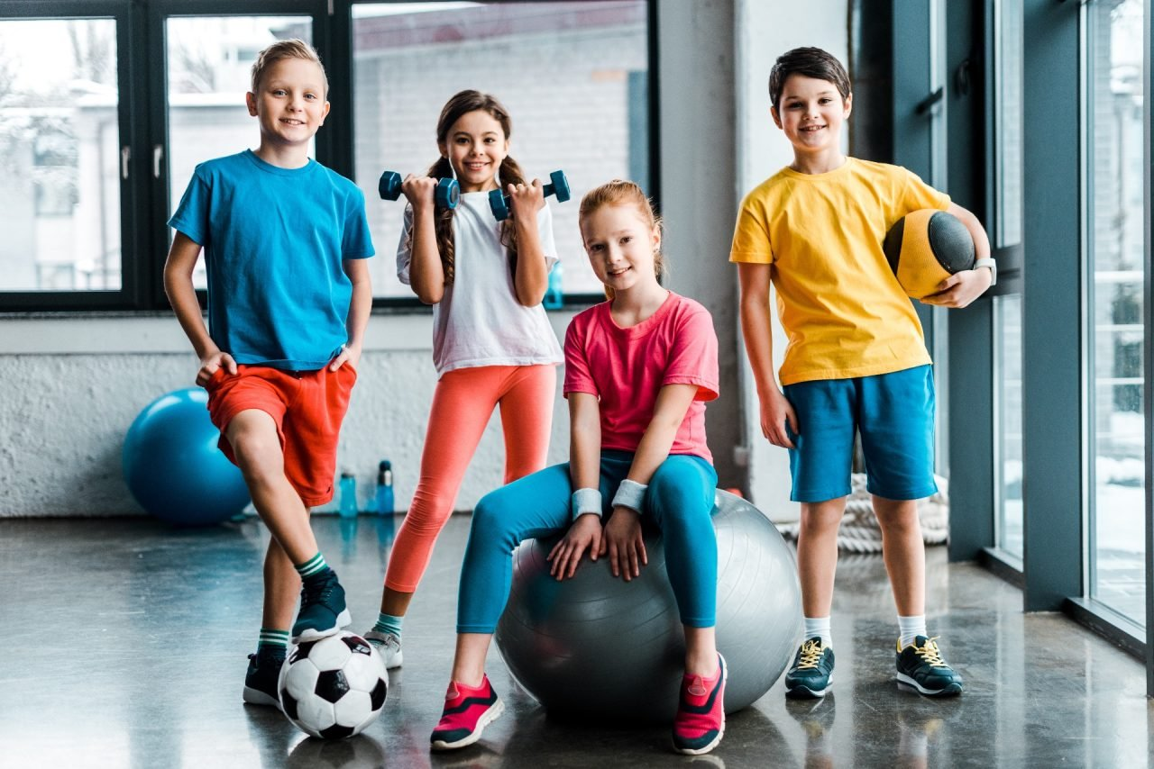
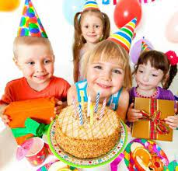
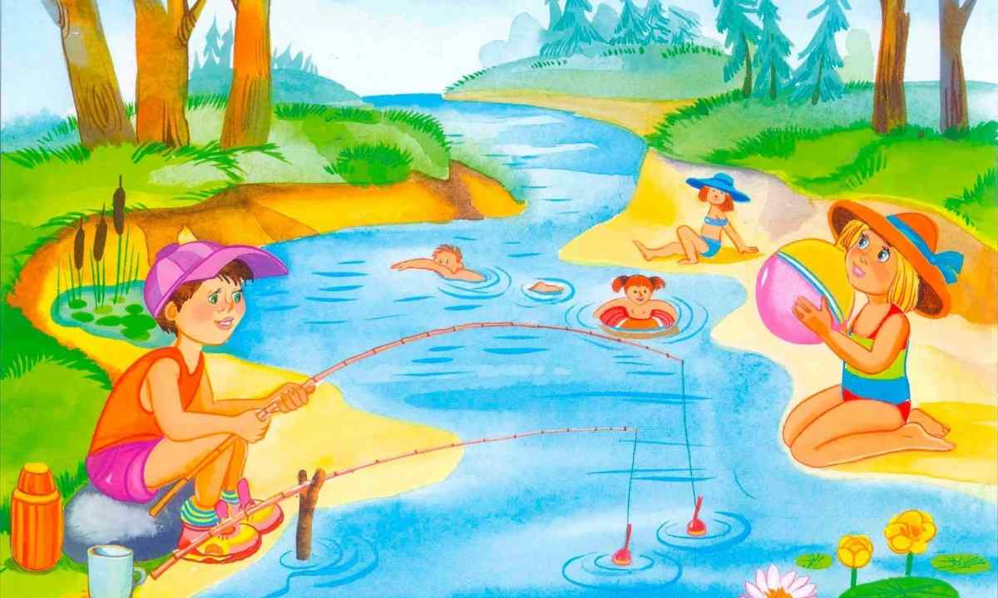
your task is to say what clothes we wear in the following situations:

Slide 7
Guess the third round - code
third round code
6. 15.15.4.

Slide 8
Soft and sweet and almost round. Color is a greeny-brown. Eat it with the skin or bare. It’s a juicy…!

Slide 10
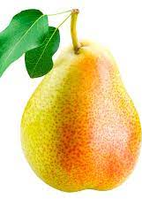
pear

Slide 11
Clean, but not water,White, but not snow,Sweet, but not ice-cream,What is it?

Slide 12
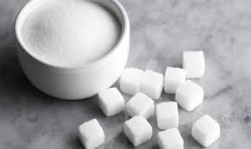
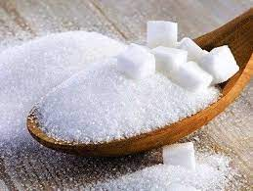
sugar

Slide 13
grow in the dark, but I come up white. On a pizza or a saladI am a delight. But be ware their trick If you eat the wrong kind they can make you sick. :

Slide 14
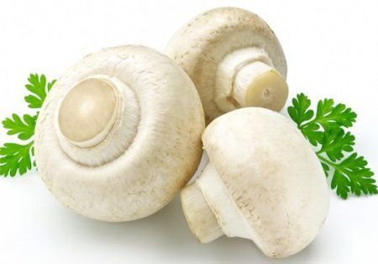
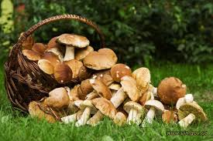
mushroom

Slide 15
1.I am yellow, I am made from milk, you eat me with bread…
2.It’s white outside,and yellow inside….

Slide 16
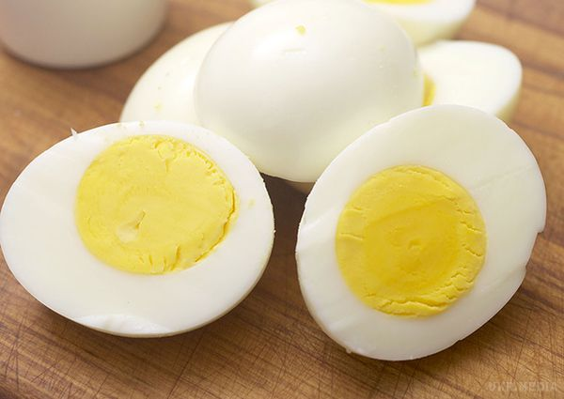
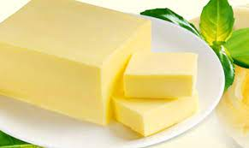
egg
butter

Slide 17
Guess the last topic
third round code
18.5.19.20

Slide 18
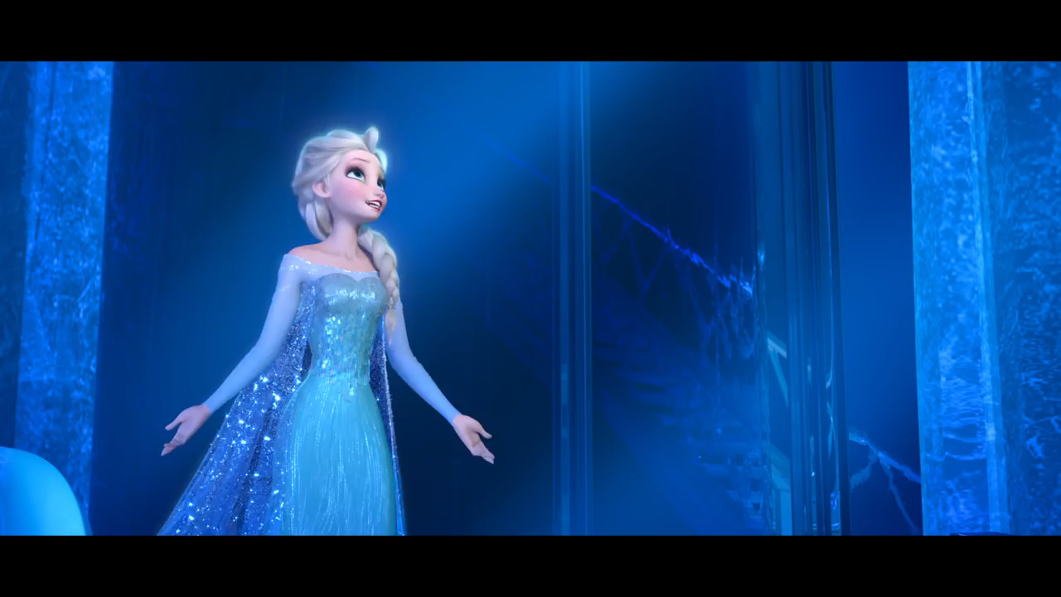
What does Elsa ask her sister for?
(Про що Ельза просить сестру?)
Ні про що. Все гаразд
Не підніматися
Не вибачатися
Не згадувати про те.що було раніше

Slide 19
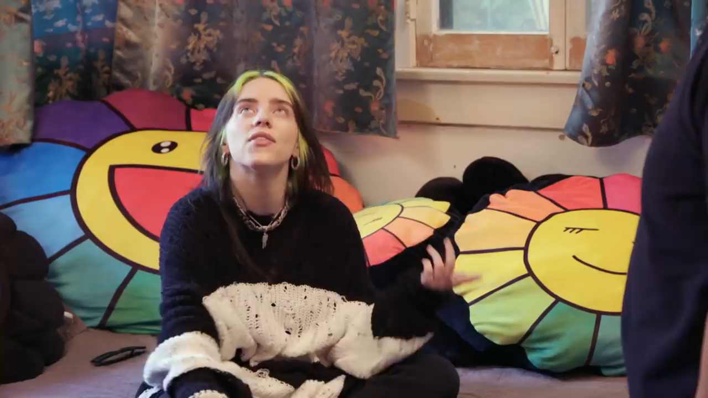
What pet is Billie Eilish talking about?
Cat
Spider
Dog
parrot

Slide 20
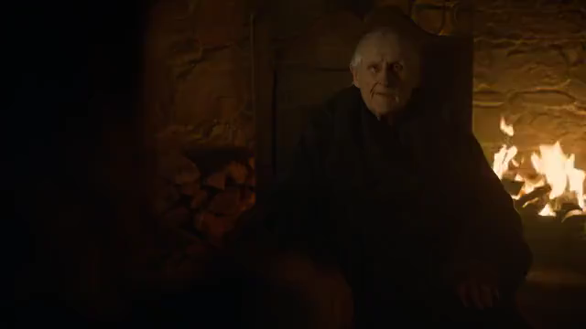
What was the question

