Slide 1
Famous painters of nowadays

Slide 2
Why do people make art?
- To earn money
- To enjoy
- To create something new
- For self-expression

Slide 3
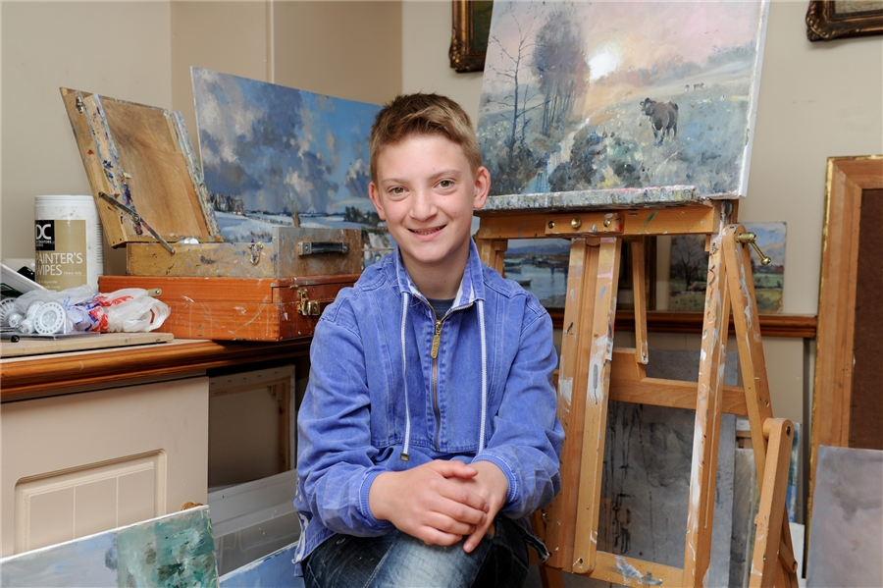
Kieron Williamson
When he was five, he started to draw sketches of boats that he saw on a family trip to Cornwall, England. This was the start of Kieron’s love of drawing. The more he drew the more complex his drawing became. He spent time with local artists in his hometown of Norfolk. They helped him build his skills in drawing and painting. He now creates pictures using oil paints, pastels and watercolors. Today nine-year-old Kieron is considered to be a child prodigy. Around the world, people admire his beautiful artwork, including many famous people. The young artist said: “I like creating art because it’s fun and inspiring”

Slide 4
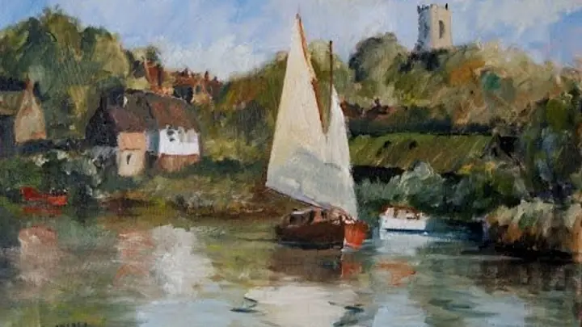
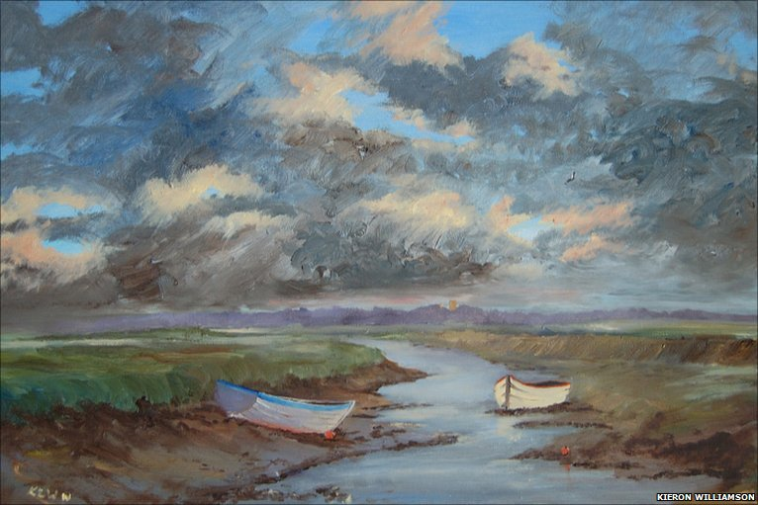

Slide 5
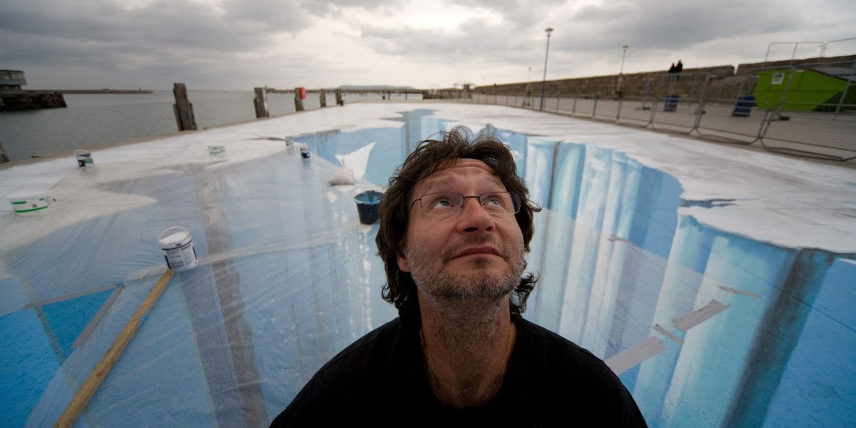
Edgar Mueller
He is an expert street painter from Germany. You can find his paintings all around the world at festivals and at public walkways. His three-dimensional paintings include waterfalls, canyons and more. Mueller uses washable paint or chalk, a variety of paintbrushes and string. His work helps people to look at a place differently.

Slide 6
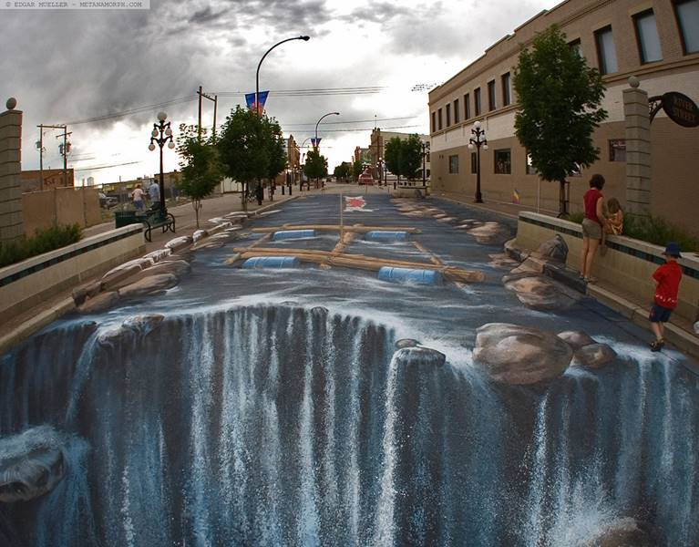
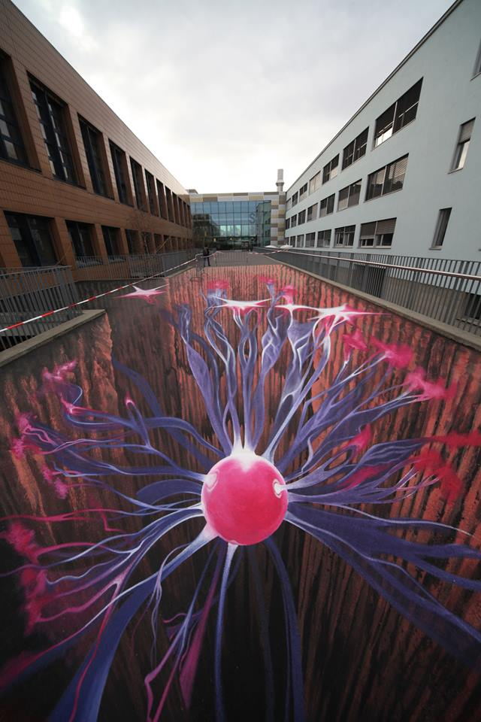

Slide 7
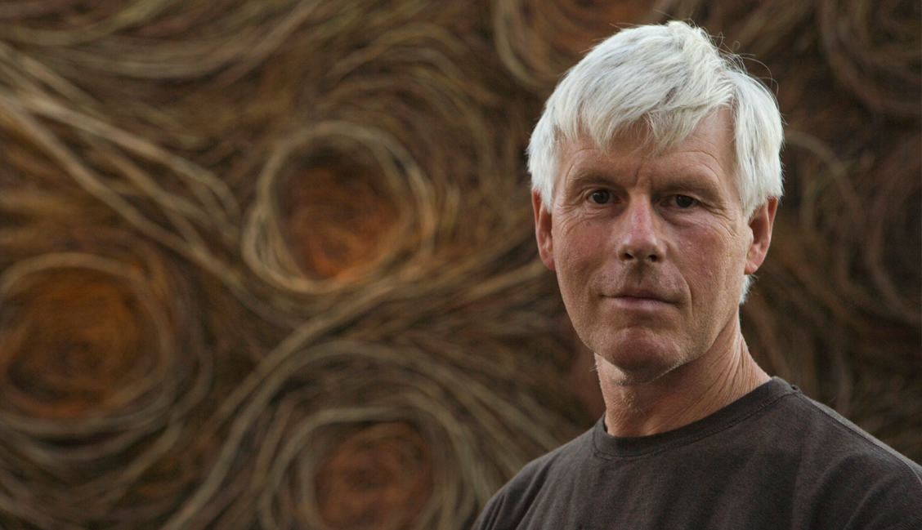
Patrick Doherty
He combines his love of nature with his skills as a carpenter. His goal is “to build a great sculpture to excite people’s imaginations”. You can see his large-scale sculptures in many places around the world. Doherty’s sculptures are made of young trees or saplings. The saplings are flexible, so he can bend them into rounded shapes. He keeps them together by weaving the saplings around each other. Building the sculpture is a great job, so local community helps Doherty with his project. Many volunteers help to collect the saplings, mark out the space and build the sculpture. The sculptures are temporary. They will decompose or break down over time.

Slide 8
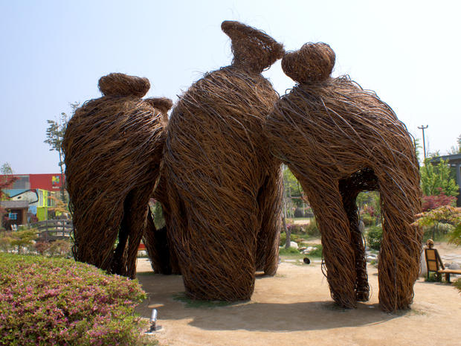
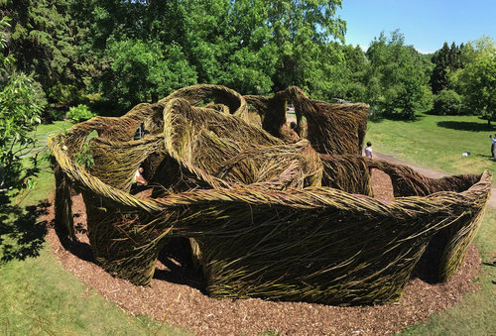

Slide 9
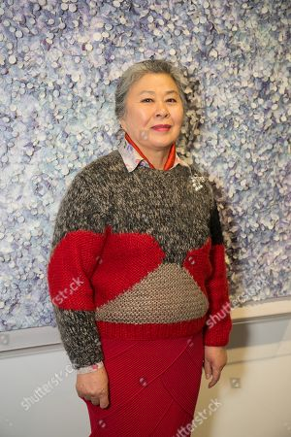
Sung Hee Cho
When you look at her artwork, you see small pieces of brightly colored paper on a large canvas. It may seem disorderly with colors scattered around. However, if you step back, you can imagine the stars, galaxies and the beauty of the universe. Cho combines traditional Korean paper with paint. First, she paints the canvas. Then she cuts out pieces of hanji into small shapes, such as flower petals. Next, she dyes and paints the small pieces of paper into a different color. The she glues thousands of them onto the canvas in layers to capture the glimmer of light. She repeats this process over and over again. She wants to create artwork that is as magical as stars.

Slide 10
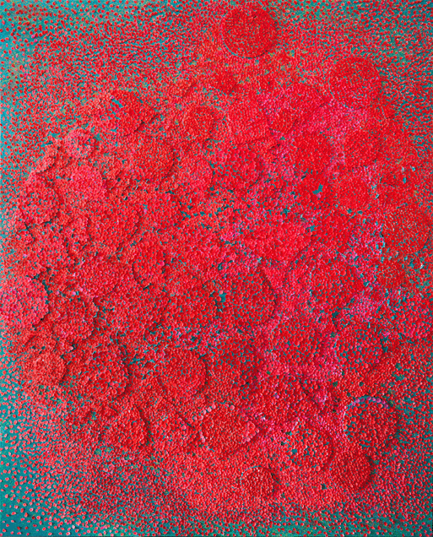
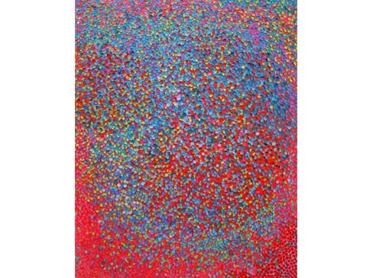

Slide 11
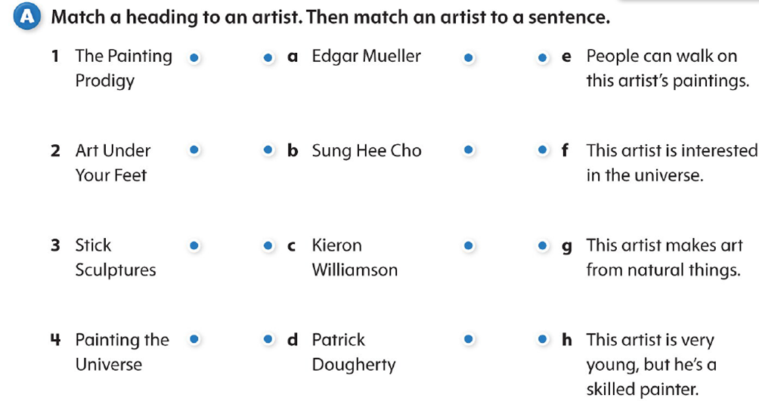

Slide 12
Task B. Answer the questions:
Who helped Kieron Williamson build his skills?
How do people become a part of an Edgar Mueller painting?
Who helps Patrick Doherty build his sculptures?
What is the Korean name for the paper Sung Hee Cho uses?
What is your favorite type of art to create? Why do you create it?

Slide 13
A special guest

Slide 14
Summing up
- I can name some modern artists,
- I can lead a conversation on this topic,
- I can make up a dialogue concerning this theme,
- I can answer questions why people create art

Slide 15
Homework: Find the information about new trends in art , bring this information about new modern artists, about new directions and display us their works.

Slide 16


